Slide 1
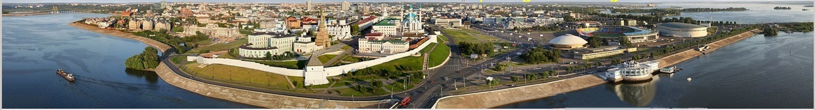
Photon echo quantum memories
S. A. Moiseev
Kazan Quantum Center, Kazan National Research Technical University
named after A.N. Tupolev, 10 K. Marx Street, Kazan 420111, Russia, Russia
KQC
2 0 1 4
Volga river

Slide 2
Kazan Quantum Center KNRTU-KAI
Dr. N.M.Arslanov, К. I. Gerasimov, Dr. V.Gleim,
N. S. Perminov – senior scientists, M. S. Smirnov – engineer,
М. М. Мinnegaliev – PhD student, R.V.Urmancheev –PhD student.
Kazan Federal University, Russia,
Prof. B. Z. Malkin, Prof. O.N. Sherstyukov, Dr. S. L. Korableva, Dr. E. I. Baibekov,
PhD students: R.R. Latypov, K.V. Petrovnin, and Е. S. Моiseev,
Kazan Physical-Technical Institute of RAS, Russia,
Dr. F.F.Gubaidullin, N.S.Perminov – senior scientists
ITMO University, Department of Photonics and Optical Information Technology, Saint Petersburg, Russia
Prof. S.A.Kozlov, Dr. V.Gleim, (quantum communication group)
Institute for Perspective Studies of Science Academy of Tatarstan Republic, Russia,
Prof. S. N. Аndrianov,
Laboratoire Aimé Cotton, CNRS, Univ. Paris-Sud, Orsay, France
Prof. T. Chanelière, Dr. A. Louchet-Chauvet (quantum memory group)

Slide 3
Quantum memory
For optical quantum computing (P.Kok, et al, RMP, 79 135 (2007)),
Quantum repeaters (H.-J., Briegel, et.al, PRL, 81, 5932 (1998))
Quantum network (H.J. Kimble, Nature 453, 1023 (2008)).
For microwave quantum computing (B. Julsgaard, Y. Kubo, et al., Phys. Rev. A 92, 020301 (2015); Review: arXiv:1510.06565v1).
Quantum memory for universal quantum computer
C.A. P´erez-Delgado and P. Kok, Phys. Rev. A 83, 012303 (2011)

Slide 4
Квантовая память: основные требования
Current status:
1. Nanosecond time scale,
2. Efficiency ~ 90 % recovery fidelity ~ 97%;
3. 1000-light temporal modes are possible, there are a number of experiments with 10-100 photonic qubits;
4. The first experiments on the implementation of QM in optical waveguides, resonators ... (so far with low efficiency);
5. Rare earth ions in inorganic crystals, P in Si,
NV-centers in diamond;
6. Storage time up to a few hours is possible , usually ~ 1 ms; There are experiments with 1 sec. cesium (low QE~3%); 1 sec. Pr:YSO (Helium temp, low eff.)
7. Helium temp.: solid state media,
room temp.: NV-centers, atomic gases: Rb; cesium (low QE~3%)
8. Simple linear manipulations are demonstrated (GEM protocol); there are a number of proposed schemes.
9. In progress;
10. In progress, there are first promising experiments.
(QE~16.5%)
1. High operation rate;
2. High efficiency and fidelity (>99.99%);
3. Multimode capacity;
4. Integration in a quantum scheme, the implementation in the circuits on the chip and nanometer level;
5. Solid state quantum information carrier;
6. Long lived storage (> 1 msec needed for qu.repeater);
7. Temperature of QM medium;
8. Using quantum memory for simple quantum manipulations;
9. Implementation of quantum repeaters based on optical quantum memory;
10. QM for superconducting quantum computing.
…

Slide 5
Reviews on quantum memory
[1]. Lvovsky Alexander I., Sanders Barry C., Tittel Wolfgang. Optical quantum memory //Nat. Pho­tonics.- 2009. - dec. - Vol. 3, no. 12. - Pp. 706-714.
[2]. Hammerer Klemens, Sorensen Anders S., Polzik Eugene S. Quantum interface between light and atomic ensembles //Rev. Mod. Phys.- 2010. - Apr. - Vol. 82. - Pp. 1041-1093.
[3]. Quantum memories / Simon, C., Afzelius, M., Appel, J. et al. //Eur. Phys. J. D.- 2010. - Vol. 58, no. 1. - Pp. 1-22.
[4]. Photon-echo quantum memory in solid state systems / W. Tittel, M. Afzelius, T. Chaneliere et al. //Laser & Photonics Reviews.- 2010. - Vol. 4, no. 2. - Pp. 244-267..
[5]. Prospective applications of optical quantum memories / F. Bussieres, N. Sangouard, M.Afzelius et al. // J. Mod. Opt.- 2013. - oct. - Vol. 60, no. 18. - Pp. 1519-1537.
[6]. K. Heshami, D.G. England, P.C. Humphreys et al. Quantum memories: emerging applications and recent advances. // J. Mod. Opt.- 2015. - preprint.http://arxiv.org/abs/1511.04018.
[7] Lijun Ma, Oliver Slattery and Xiao Tang, Optical quantum memory based on electromagnetically induced transparency J. Opt. 19 (2017) 043001 (24pp)
[8] T Chanelière, G Hétet, N Sangouard Quantum optical memory protocols in atomic ensembles - arXiv preprint arXiv:1801.10023, 2018 - arxiv.org
Special issues on QM
[1]. Quantum memory J. Phys. B: At. Mol. Opt. Phys.- 2012. - Vol. 45. - Pp. 120201-124021.
[2]. Focus on Quantum memory New J. Phys.- 2015. - Vol. 17. - P. 050201.
[3]. Special Issue CFP: Quantum Memory, Journal of Modern Optics. – 2016.

Slide 6
Optical quantum memory based on atomic ensembles
EIT based Quantum Memory
M. Fleischhauer and M. D. Lukin, PRL. 84, 5094, (2000).
Chen Y-H et al 2013 Phys. Rev. Lett. 110 083601 (QE=78%)
Off-resonant Raman scheme
control
control
A.E.Kozhekin, K. Molmer, and E.S.Polzik, Phys. Rev. A 62, 033809 (2000).
Reim K F, et al., A Phys. Rev. Lett. 107 053603 (2011) (QE=30%)
input
output
time
High-speed atomic memory
A.Gorshkov, A Andre, M Fleishhhauer, A.S.Soensen and M.D.Lukin PRL 98, 123601 (2007).
A.Kalachev Phys.Rev.A. 76, 043812 (2007).
T.Golubeva, Yu. Golubev, O.Mishina, A.Bramati, J.Laurat, and E.Giacobino,
Phys. Rev. A 83, 053810 (2011).
Photon Echo Quantum Memories
S.A.Moiseev and S.Kroll, PRL. 87, 173601, (2001)- Basic scheme (CRIB).
W. Tittel, M. Afzelius, T. Chaneliere , R.L.Cone, S.Kroll, S.A.Moiseev, and M.Sellars.
Laser & Photonics Reviews.- 2010. 4, 244-267..
M.Hosseini et al Nature Commun. 2, 174 (2011) CRIB/GEM (QE - 87%)

Slide 7
Optical quantum memory based on atomic ensembles
EIT based Quantum Memory
M. Fleischhauer and M. D. Lukin, PRL. 84, 5094, (2000).
Chen Y-H et al 2013 Phys. Rev. Lett. 110 083601 (QE=78%)
Off-resonant Raman scheme
control
control
A.E.Kozhekin, K. Molmer, and E.S.Polzik, Phys. Rev. A 62, 033809 (2000).
Reim K F, et al., A Phys. Rev. Lett. 107 053603 (2011) (QE=30%)
input
output
time
High-speed atomic memory
A.Gorshkov, A Andre, M Fleishhhauer, A.S.Soensen and M.D.Lukin PRL 98, 123601 (2007).
A.Kalachev Phys.Rev.A. 76, 043812 (2007).
T.Golubeva, Yu. Golubev, O.Mishina, A.Bramati, J.Laurat, and E.Giacobino,
Phys. Rev. A 83, 053810 (2011).
Photon Echo Quantum Memories
S.A.Moiseev and S.Kroll, PRL. 87, 173601, (2001)- Basic scheme (CRIB).
W. Tittel, M. Afzelius, T. Chaneliere , R.L.Cone, S.Kroll, S.A.Moiseev, and M.Sellars.
Laser & Photonics Reviews.- 2010. 4, 244-267..
M.Hosseini et al Nature Commun. 2, 174 (2011) CRIB/GEM (QE - 87%)

Slide 8
Схемы квантовой памяти на фотонном эхе
(2001,)
CRIB
Complete absorption within IB line
Inversion of IB line
Backward echo field emission
Perfect time reversibility
(2008,2012)
(2006)
AFC
Complete absorption within IB line
Backward echo field emission
IB line consists of periodic structure of narrow lines
GEM
Complete absorption within IB line
Inversion of IB line
+ IB is determined by controllable gradient of Stark (Zeeman) shifts
(2011)
PEQM on natural IB (ROSE,…)
Complete absorption within IB line
Backward echo field emission
+ Rephasing by sequence of intensive laser pulses
(2010)
Impedance matching schemes
promising properties:
Small size samples
2. Perfect integration
(2017,2018)
(2008)
1) Microwave multiresonator
2) On-chip multi-ring optical scheme
Off-resonant Raman echo M
promising properties:
1. Provides generalized time reversibility
2. It can be used for CRIB/GEM, AFC, ROSE protocols
3. Provides a direct storage on long-lived levels

Slide 9
Some recent experiments on photon echo quantum memories
2010-2017:
Most efficient quantum memory for light in a crystal (69 %).
M.Hedges, et al, Nature 465, 1052–1056 (2010).
Quantum storage of photonic entanglement in a crystal.
C. Clausen, et al. Nature 469, 508–511 (2011).
A. Tiranov, et al, . arXiv:1606.07774v2
Integration of rare-earth ions in the optical waveguides for implementation of photon echo protocols
E. Saglamyurek, et al, Nature (London) 469, 512-515 (2011).
Towards elaboration of optical quantum repeaters based on the photon echo approaches in the crystals doped by rare-earth ions:
N. Sinclair, et al, Phys. Rev. Lett. 113, 053603 (2014).
E. Saglamyurek, et al, Nat. Commun. 7, 13454 (2015).
Optical waveguides created in inorganic crystal with rare-earth ions:
G. Corrielli, et al., Phys. Rev. Applied 5, 054013 (2016).
Towards non-destructive detection of photonic qubits based on AFC photon echo in Tm:LiNbO3 waveguide
Sinclair, N. et al.. Nat. Commun. 7, 13454 (2016).
Tian Zhong, et.al.,Interfacing broadband photonic qubits to on-chip cavity-protected rare-earth ensembles. Nat. comm. Sep. 2016. doi:10.1038/ncomms14107 (2016)
Tian Zhong, et.al., Nanophotonic rare-earth quantum memory with optically controlled retrieval. Science, August 2017.doi: 10.1126/science.aan5959(2017). (2017)

Slide 10
Towards microwave spin echo quantum memory
Spin ensembles in microwave QED cavity
Y. Kubo, et al, Phys. Rev. Lett. 105, 140502 (2010).
D. I. Schuster, et al, Phys. Rev. Lett. 105, 140501 (2010).
B. Julsgaard, C. Grezes, P. Bertet, and K. Mølmer, Phys. Rev. Lett. 110, 250503 (2013).
M. Afzelius, N. Sangouard, G. Johansson, M. U. Staudt, and C. M. Wilson, New J. Phys. 15, 065008 (2013).
S. Probst, et. Al, Phys. Rev. Lett. 110(15), 157001 (2013).
K.I. Gerasimov, S.A. Moiseev, V.I. Morosov, R.B. Zaripov, Phys. Rev. A 90(4), 042306 (2014).
C. Grezes, et al, Phys. Rev. A 92(2), 020301 (2015).
Arcangeli, A., Ferrier, A. & Goldner, Phys. Rev. A 93, 062303 (2016).
Krimer, D. O., Zens, M., Putz, S. & Rotter, S. Laser & Photonics Rev. 10, 1023–1030 (2016).
Gerasimov, K.I., Moiseev, S.A. & Zaripov, R.B. Appl Magn Reson Volume 48, No. 795(2017).
Quantum memory with millisecond coherence in circuit QED
Matthew Reagor, et al, Phys.Rev.A. B 94, 014506 (2016)

Slide 11
Basic properties of quantum memory media
Resonant atoms
Atomic levels
|3>
out
in
in
|2>
out
Tº
single photons
and control laser fields
|1>
external electric (E) and (or) magnetic (B) fields
Quantum efficiency:
where
Fidelity:

Slide 12
Arsenal of coherent optical effects:
Coherent effects in multi-two level atomic systems:
Free induction decay, spin/photon echoes,
Dicke superradiance, Slow light, off-resonant Raman interaction…
|2 _{j} >
Atomic Hamiltonian:
E_{signal} ω₂₁
|1 _{j}>
Inhomogeneous and homogeneous broadening of resonant line
G(ω-ω_{o})
γ(ω-ω_{j})
ω
Light spectrum

Slide 13
Photon Echo Quantum Memory
(CRIB scheme →AFC, Roze, Raman protocols, other variants)
Spatial Reversible (Backward) Scheme of Photon Echo:
S.A.Moiseev and S.Kroll, Phys.Rev.Lett.(2001).
Δ_{j}(t’)
|3⟩
-Δ_{j}(t)
Δτ
Δ(τ-t)=0
t > t_{o}:
Δ → - Δ
E_{signal}
E₁
E₂
E_{echo}
| 2⟩
|1⟩
Time
t_{o}
Notes:
13

Slide 14
Spatial reversible (backward) free space scheme of photon echo QM:
Medium
E₁
E_{signal}
Resonant absorption
G(ω-ω_{o})
E_{signal}
|3⟩
E₁
| 2⟩
ω
|1⟩

Slide 15
Spatial reversible (backward) free space scheme of photon echo QM:
Medium
E₁
Resonant absorption
G(ω-ω_{o})
E_{signal}
|3⟩
E₁
| 2⟩
ω
|1⟩

Slide 16
Spatial reversible (backward) free space scheme of photon echo QM:
Medium
E₁
Resonant absorption
G(ω-ω_{o})
E_{signal}
|3⟩
E₁
E₂
E_{echo}
| 2⟩
ω
|1⟩

Slide 17
Spatial reversible (backward) free space scheme of photon echo QM:
Medium
Resonant absorption
G(ω-ω_{o})
E_{signal}
|3⟩
Δ→-Δ:
E₁
E₂
E_{echo}
| 2⟩
ω
|1⟩

Slide 18
Spatial reversible (backward) free space scheme of photon echo QM:
Medium
E₂
Resonant absorption
G(ω-ω_{o})
E_{signal}
|3⟩
Δ→-Δ:
E₁
E₂
E_{echo}
| 2⟩
ω
|1⟩

Slide 19
Spatial reversible (backward) free space scheme of photon echo QM:
Medium
E₂
Resonant absorption
G(ω-ω_{o})
E_{signal}
|3⟩
Δ→-Δ:
E₁
E₂
E_{echo}
| 2⟩
ω
|1⟩

Slide 20
Spatial reversible (backward) free space scheme of photon echo QM:
Medium
E₂
E_{echo}
Resonant absorption
Time reversal dynamics → time reversal shape of the output light pulse
G(ω-ω_{o})
E_{signal}
|3⟩
Δ→-Δ:
E₁
E₂
E_{echo}
| 2⟩
ω
|1⟩

Slide 21
Photon Echo Quantum Memory
S.A.Moiseev, M.I. Noskov. Laser Physics Letters (2004), 1, № 6, 303-310
Maxwell-Bloch equations
Absorption
stage
Echo
emission

Slide 22
Photon Echo Quantum Memory
S.A.Moiseev, M.I. Noskov. Laser Physics Letters (2004), 1, № 6, 303-310
Maxwell-Bloch equations
Absorption
stage
Echo
emission
Δ→ - Δ, E_{echo}→ - E_{o} t→ - t
-B.Kraus, et.al., PRA. 73, 020302(R) (2006).

Slide 23
Maxwell-Bloch equations
S.A.Moiseev, M.I. Noskov. Laser Physics Letters (2004), 1, № 6, 303-310
S. A. Moiseev, and J.-L. Le Gouët, J. Physics B: At. Mol. & Opt. Phys 45, 124003, (2012)
Absorption stage
Excited atomic coherence:
Dispersion
Dephasing
Absorption effect

Slide 24

Some basic properties of CRIB
Echo signal irradiation
Large optical depth: αL>>1
Misphasematching
|3⟩
E₁
E₂
E_{echo}
| 2⟩
$$ω_{21}$$
|1⟩

Slide 25

Basic properties of free space photon echo QM
Echo signal irradiation
Large optical depth: αL>>1
Misphasematching
|3⟩
k₁
Medium
k₂
E₁
E₂
E_{echo}
k_{s}
| 2⟩
k_{echo}
$$ω_{21}$$
|1⟩
Resonant absorption
k₂
-k₁
k_{echo} = k_{s} – k₁+ k₂
k_{echo}
k_{s}

Slide 26
Arbitrary initial quantum state of light:
S.A. Moiseev. J. of Phys. B: Atom., Mol. & Opt. Phys. 40, 3877-3891 (2007).
The retrieved quantum state
ξ
,
k
)
=
c
(
t
−
t
'
)
∑
n
κ
−
n
χ
n(
t
Spectrum:
Initial field Photon echo field
m
=
1
m
12
ω
ω
22

Slide 27
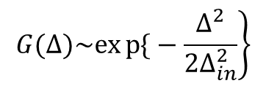
Maxwell-Bloch equations
Gaussian inhomogeneous broadening
Natural IB
Gradient Memory
Atomic frequency Comb
$$\left.G(∆)\sim exp{\{}−\frac{∆^{2}}{{2∆}_{in}^{2}}\right\}$$
S. A. Moiseev, PRA (2011).
D. L. McAuslan, et.al, PRA (2011).
V. Damon et al., NJP (2011).
A.L.Alexander, et al,
PRL(2006).
H. De Riedmatten, et al.,
Nature (2008)
G(Δ)
G(Δ)
Δ_{in}
Linewidth

Slide 28
Maxwell-Bloch equations
Gaussian inhomogeneous broadening
Useful for broadband storage
Natural IB
Gradient Memory
Atomic frequency Comb
$$\left.G(∆)\sim exp{\{}−\frac{∆^{2}}{{2∆}_{in}^{2}}\right\}$$
S. A. Moiseev, PRA (2011).
D. L. McAuslan, et.al, PRA (2011).
V. Damon et al., NJP (2011).
A.L.Alexander, et al,
PRL(2006); S.A. Moiseev, and N.M. Arslanov. PRA. 78, 023803 (2008).
.
H. De Riedmatten, et al.,
Nature (2008)
G(Δ)
G(Δ)
Δ_{in}
Linewidth

Slide 29
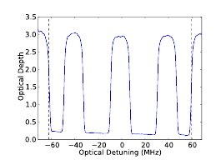
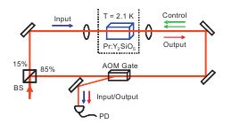
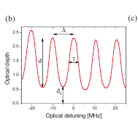
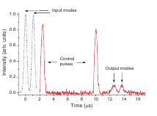
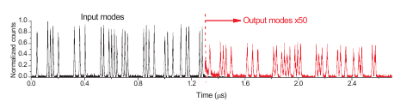
Photon Echo QM for multi-mode light fields. Experimental demonstration of quantum storage
Quantum storage of 64 light pulses: I.Usmani, M.Afzelius, H.de Riedmatten, and N.Gisin, Nature Comm.1,1 (2010) (Nd 3+ :YVO 4 crystal).
Quantum storage of 1064 temporal light modes:
M. Bonarota, J.-L. Le Gouet, and T. Chaneliere, New J of Physics 13 (2011) 13013
Experiments with highest quantum efficiency
M. Hosseini, B. M. Sparkes, P. K. Lam, and B. C. Buchler, Nature Commun.1,1, (2011) (gas, room temperature, quantum efficiency = 87 %, storage time ~ few μs).
Y.-W. Cho , et al , Optica, ol. 3, No. 1, 100, (2016) (cold gas, quantum efficiency = 87 % storage time ~ 1 ms).

Slide 30
Проект улучшения AFC протокола
К широкополосной эффективной квантовой памяти
на AFC протоколе
S. A. Moiseev, and J.-L. Le Gouët, J. Physics B: At. Mol. & Opt. Phys 45, 124003, (2012)
Н.М. Арсланов, С.А.Моисеев, Квантовая Электроника, Том 47, № 9, с. 783-789 (2017).
γ
резкость F=Δ/γ
G(Δ/Δ_{in})
Δ_{in}
Δ
Δ_{o}
ω

Slide 31
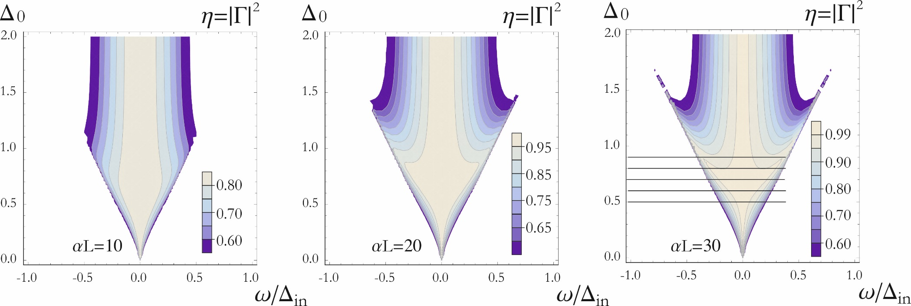
Проект улучшения AFC протокола
К широкополосной эффективной квантовой памяти
на AFC протоколе
Н.М. Арсланов, С.А.Моисеев,
Кв. Электроника 47, 783 (2017).
G(Δ/Δ_{in})
Δ_{in}
Δ_{o}
ω
Δ_{qm}

Slide 32
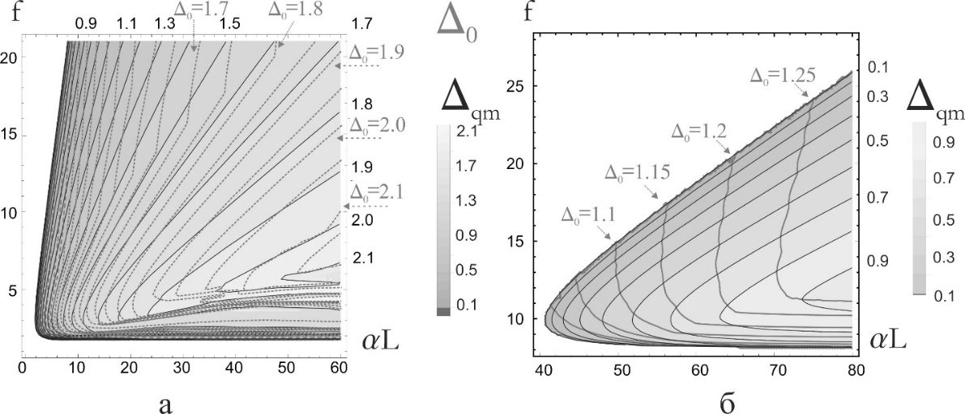
Карты расчета максимальной ширины квантовой памяти Δ_{qm}
и значений АЧГ (AFC) структуры Δ₀ для двух значений эффективности 10%, 90% в зависимости от оптической плотности αL и резкости f cтруктуры
.
Н.М. Арсланов, С.А.Моисеев, Оптика и спектроскопия (2019 в печати).
Карта максимальной ширины Δ_{qm} при оптимальной Δ₀ в единицах Δ_{in}. Стрелки указывают на изолинии максимальных значений Δ_{opt0} для различной эффективности = 10% (а) и 90% (б).

Slide 33
Photon echo QM in optimal QED cavity
Cavity schemes
S.A. Moiseev, S.N. Andrianov, and F.F. Gubaidullin Phys. Rev. A 82, 022311 (2010) (CRIB)
M.Afzelius, C.Simon Phys. Rev. A 82, 022310 (2010) (AFC)
κ
photons
semitransparent mirror
resonant atoms
mirror
cavity mode
Resonant line of single monochromatic atomic group
Inhomogeneously broadened line
N - number of atoms
g – coupling constant
of atom-photon interaction
Δ_{in}
Δ
ω
|2>
|1>

Slide 34
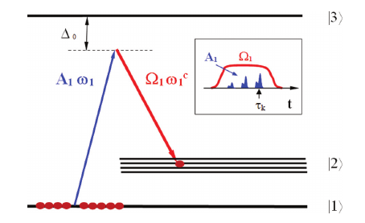
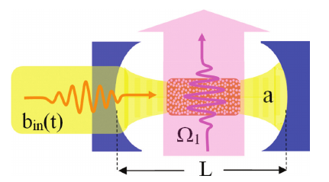
Off-resonant Raman echo QM in single mode cavity
S.A. Moiseev. Phys.Rev.A 88, 012304 (2013).

Slide 35
Off-resonant Raman echo QM in single mode cavity
S.A. Moiseev. Phys.Rev.A 88, 012304 (2013).
A.E.Kozhekin, K. Molmer, and E.S.Polzik, Phys. Rev. A 62, 033809 (2000).
+ cavity
S.A.Moiseev and S.Kroll, PRL. 87, 173601, (2001)

Slide 36
Hamiltonian (quantum optics)
Basic Hamiltonian of atoms (electron spins) and photon fields
Perturbation and interaction parts:
Inhomogeneous and homogenous broadenings
Spectral detunings of the field modes
Atom-cavity mode interaction
Interaction of cavity mode with other field modes
k=1- external (waveguide) modes; 2- bath modes
Notes:
36

Slide 37
Quantum efficiency
Storage:
Spectral efficiency Z(ν,…,):
where:
- is a total spectral width, including inhomogeneous broadening
Notes:
37

Slide 38
Photon echo QM in optimal QED cavity
κ
κ
Echo photons
resonant atoms
mirror
cavity mode
(CRIB)
(AFC)
It has been found that two impedance matching conditions should be satisfied for
Broadband efficient quantum memory:
Basic impedance matching:
Spectral matching condition:
Z (ν,…)
Spectral efficiency of quantum memory
Δ_{in}
κ

Slide 39
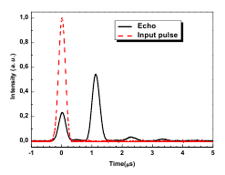
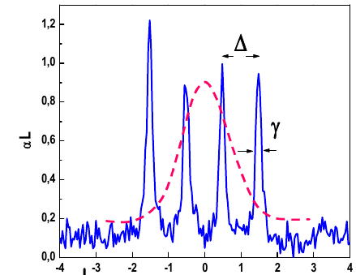
First experiments
Fabry-Perot cavity (on crystal surfaces) 0.05 % Pr3+ : Y2SiO5) :
Sabooni M., Li Q., Kroll S and Rippe L. Phys. Rev. Lett. 110 133604 (2013)
Sabooni M., Kometa S.T., Thuresson A., Kroll S. and Rippe L. New Journal of Physics 15, 035025 (2013).
(QE=58%)
Rephasing (reemission) time:
Finesse F=Δ/γ=4.5
39
Quantum efficiency =58% (Record for AFC-protocol)
External optical cavity
P. Jobez, I. Usmani, N. Timoney, C. Laplane, N. Gisin, M. Afzelius. New Journal of Physics 16, 083005 (2014) (QE=53%)
R A Akhmedzhanov, L A Gushchin, A A Kalachev, N A Nizov, V A Nizov, D A Sobgayda and I V Zelensky, Laser Phys. Lett. 13, 115203 (2016). (QE=3% for 10 nsec pulse)

Slide 40
Towards microwave quantum memory for superconducting quantum computer
Recent experiments on microwave spin echo quantum memory on NV-centers
C. Grezes, B. Julsgaard, Y. Kubo, et al., Multimode Storage and Retrieval of Microwave Fields in a Spin Ensemble Phys.Rev.X, 4, 021049 (2014).
Grezes, B. Julsgaard, Y. Kubo, et al., Storage and retrieval of microwave fields at the single-photon level in a spin ensemble Phys. Rev. A 92, 020301 (2015); Review: arXiv:1510.06565v1 . Quantum efficiency– 0.3 %

Slide 41
New quantum memory schemes on photon/spin echo
for integration in quantum circuits
Impedance matching quantum memory
S.A. Moiseev, S.N. Andrianov, and F.F. Gubaidullin Phys. Rev. A 82, 022311 (2010)
Первые подтверждающие эксперименты
Sabooni M., Li Q., Kroll S and Rippe L. Phys. Rev. Lett. 110 133604 (2013)
P. Jobez, I. Usmani, N. Timoney, C. Laplane, N. Gisin, M. Afzelius. New Journal of Physics 16, 083005 (2014)
R A Akhmedzhanov, L A Gushchin, A A Kalachev, N A Nizov, V A Nizov, D A Sobgayda and I V Zelensky, Laser Phys. Lett. 13, 115203 (2016).
Integrated QM and multi-qubit quantum RAM
S. A. Moiseev, and S.N. Andrianov. J. Phys. B: At., Mol. & Opt Phys. 45, 124017 (9pp) (2012)
E. S. Moiseev & S. A. Moiseev Journal of Modern Optics, 63, No. 20, 2081–2092. (2016):
S.A.Moiseev and S.N. Andrianov Optics and Spectroscopy, Vol. 121, No. 6, pp. 886–896 (2016).

Slide 42
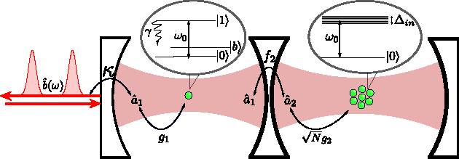
Проект
Квантовая РАМ на фотонном эхе в резонаторах
E. S. Moiseev, and S. A. Moiseev. Time-bin quantum RAM. Journal of Modern Optics, 63, No. 20, 2081–2092 (2016).
Optical scheme (and microwave scheme)
Control
atom
Atomic ensemble
ωph = ω31 = ωo ≈ ωj
Impedance matching
Spectral impedance matching :
09.03.2015

Slide 43
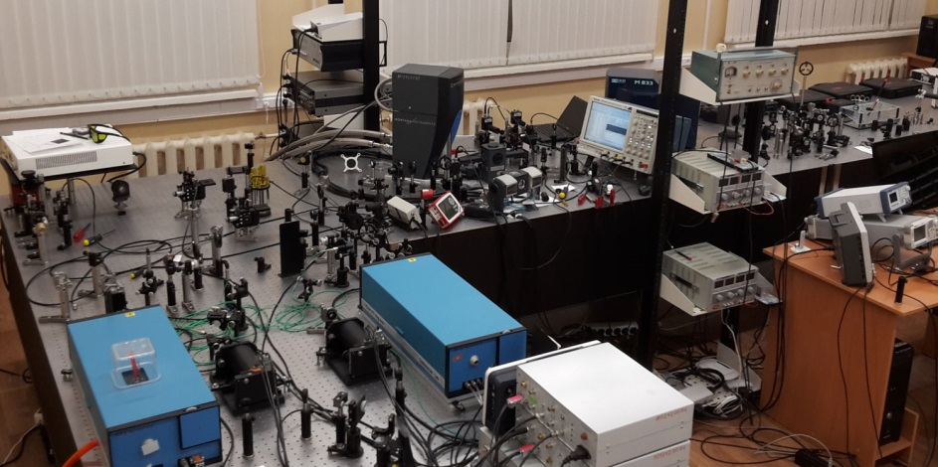
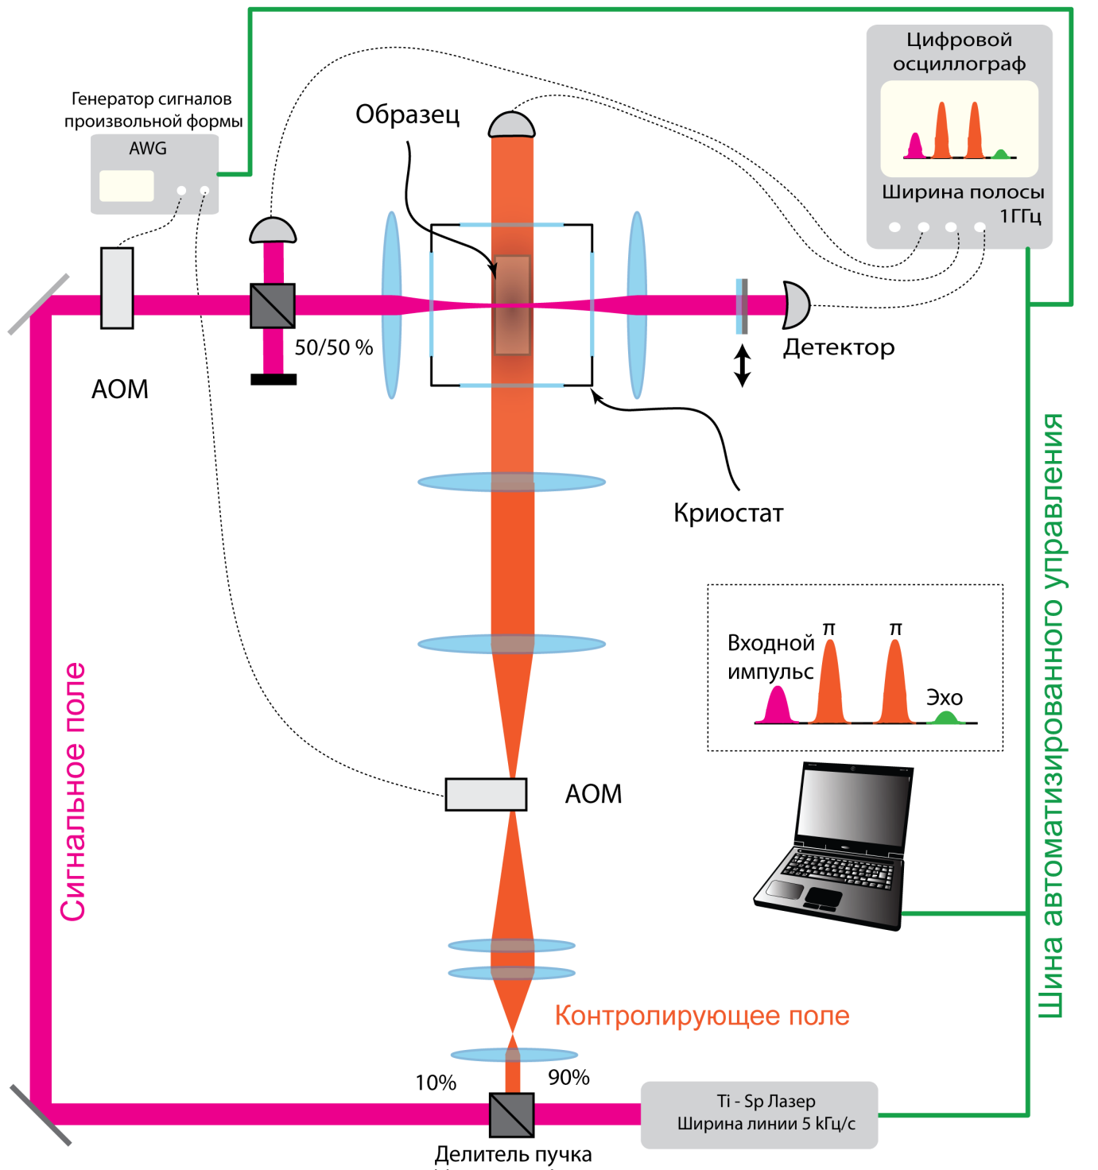

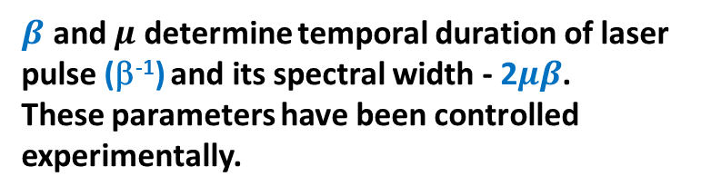
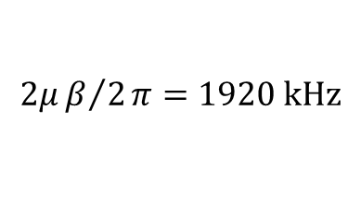
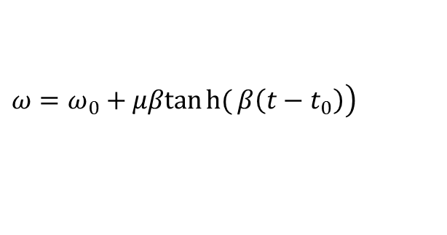
Optical scheme
Our first experiment towards the photon echo QM in optical cavity
K. I. Gerasimov , M. M. Minnegaliev , S. A. Moiseev , R. V. Urmancheev, T. Chanelière, and A. Louchet-Chauve
Quantum Memory in Orthogonal Geometry of Scilenced Echo Retrieval Optics and Spectroscopy, 2017, Vol. 123, No. 2, pp. 209–215.
Experimental setup for observation of Scilenced photon echo in orthogonal geometry of laser field control
кристалл Y₃Al₅O₁₂: Tm³⁺
Crystal
Digital
oscilloscope
Generator of pulses
with arbitrary shape
crystal
Spectral width
1GHz
Detector
Cryostat
$$ℇ\left(t\right)=ℇ_{0}\operatorname{sech}\left(β\left(t−t_{0}\right)\right),$$
Input
pulse
echo
$$\left.ω=ω_{0}+μβtanh{(}β\left(t−t_{0}\right)\right)$$
Signal field
Bus of automatic control
$β$ and $μ$ determine temporal duration of laser pulse (β⁻¹) and its spectral width - 2$μβ$.
These parameters have been controlled experimentally.
Controlling laser pulses
Ti-Sp Laser
$$2μβ/2π=1920 kHz$$
beamsplitter
linewidth 5KHz

Slide 44
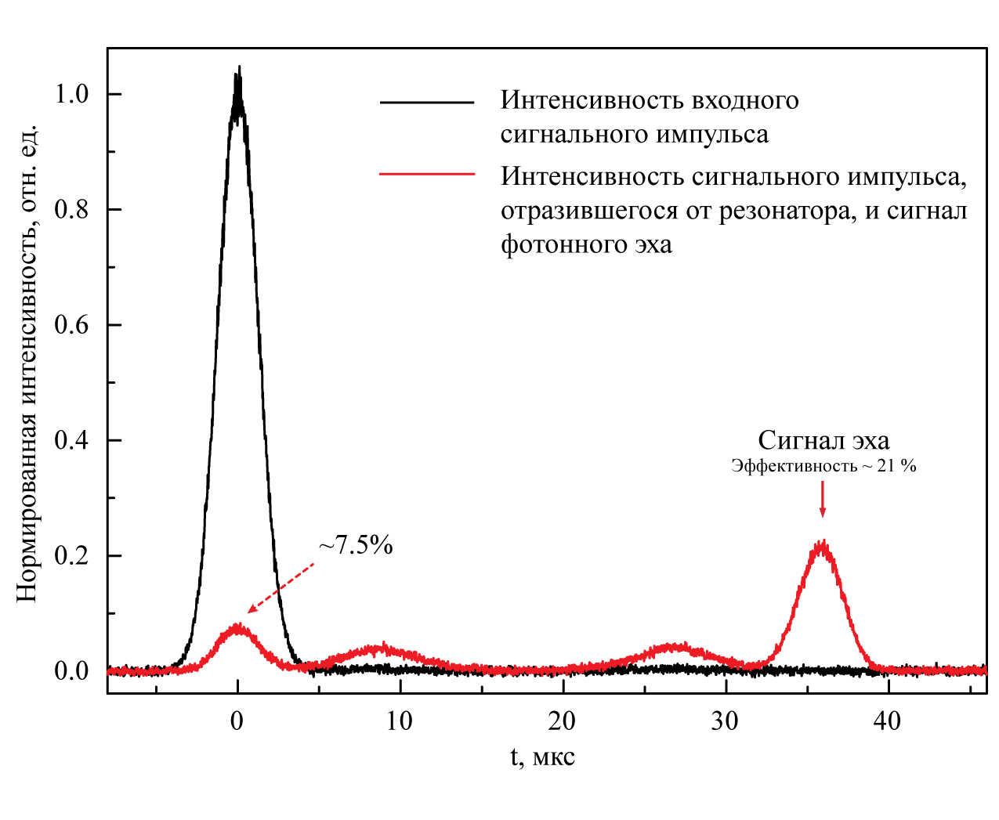

ROSE- photon echo protocol
On crystal Y₃Al₅O₁₂: Tm³⁺ in optical resonator
M.M. Minnegaliev, K.I. Gerasimov, R.V.Urmancheev, and S.A. Moiseev. Quantum memory in scheme of silenced echo retrieval in optical resonator. Quantum Electronics (2018, in press).
Intensity of input signal
Intensity of input signal reflected from resonator and signal of photon echo
Normalized intensity
Echo pulse
Efficiency – 21 %
I_{e} = I₀ ⋅ exp (-2⋅( t / T_{m} )^{x})
Максимальная эффективность
39.4 %
Maximum efficiency – 39.4 %
T_{m}= 55 мкс, x = 1.8

Slide 45
Off-resonant Raman echo QM in single mode cavity
(towards using crystal with rare-earth ions)
проект в резонаторе:
S.A. Moiseev. Phys.Rev.A 88, 012304 (2013).
Storage on
Long-lived levels

Slide 46
Off-resonant Raman echo QM in single mode cavity
(towards using crystal with rare-earth ions)
проект в резонаторе:
S.A. Moiseev. Phys.Rev.A 88, 012304 (2013).
Storage on
Long-lived levels
A.E.Kozhekin, K. Molmer, and E.S.Polzik, Phys. Rev. A 62, 033809 (2000).
S.A.Moiseev and S.Kroll, PRL. 87, 173601, (2001),
S.A. Moiseev, S.N. Andrianov, and F.F. Gubaidullin Phys. Rev. A 82, 022311 (2010)
S. A. Moiseev, and W. Tittel. New J Phys. 13, 063035 (2011).

Slide 47
Квантовая память на нерезонансном рамановском эхе в резонаторе
S.A. Moiseev. Phys.Rev.A 88, 012304 (2013).
проект в резонаторе:
Modified impedance matching:
Spectral impedance matching :
Possiblity of realization in crystals with rare-earth ions :
Z (ν,…)
Δ_{in}
κ
Spectral efficiency of quantum memory
Δ_{in}⁽¹³⁾ < 24 Mhz for Er ions!
Δ_{o} ≈10Δ _{in}⁽¹³⁾ =24 10 ⁷ Hz.

Slide 48

Temporal scheme of interaction
Ω₁
Ω₂
Ω₃
Ω₄
Ω₅
Ω₆
Signal
τ_{k}
t₀
T₀
Echo
τ_{k}+2T₀
t
|3⟩>
Δ _{0,2}
Δ ₀
Ω₂
Ω₃
Ω₂ ω₂^{c}
Ω₃ ω₃^{c}
L_{z}
t_{o}
t
Ω₂ ω₂^{c}
Ω₃ ω₃^{c}
|2⟩
|1⟩

Slide 49
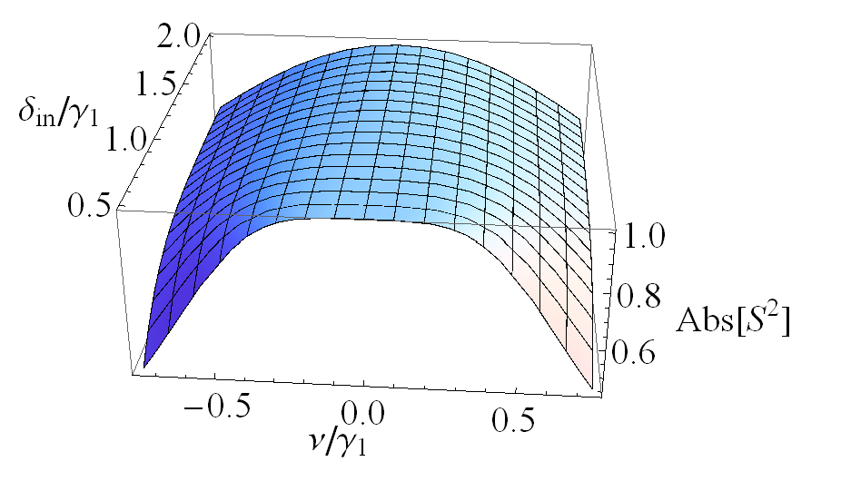
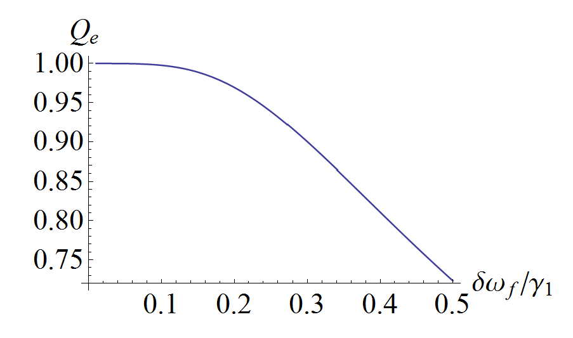
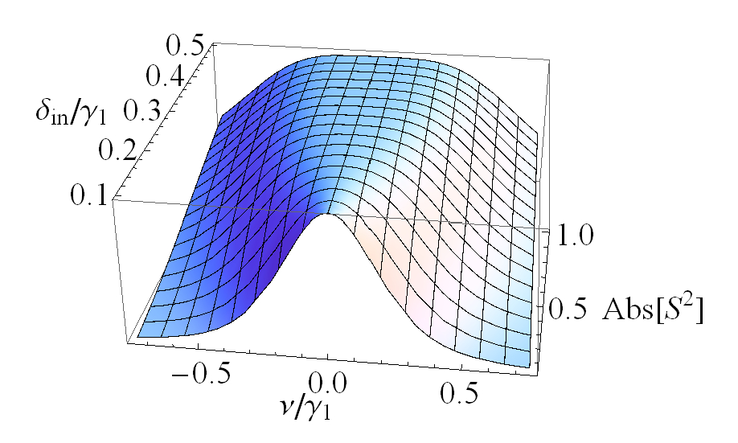
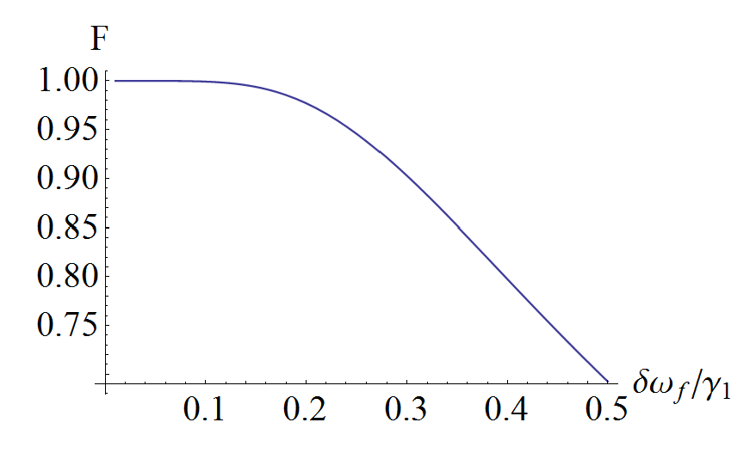
Spectral range of effective storage
Quantum efficiency
Fidelity

Slide 50
Схема реализации селективной многомодовой КП на нерезонансном рамановском эхе в резонаторе
Проект
Стадия сохранения фотонных кубитов :
3-rd
2-nd
1-st
3-rd
1-st
2-nd
Пространственное кодирование фотонных кубитов

Slide 51
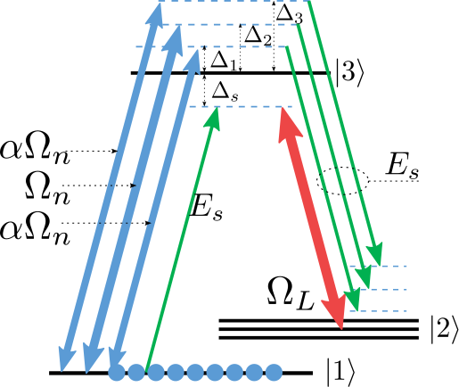
Проект
Broadband Raman echo quantum memory in white QED cavity
С.А.Моисеев, Е.С.Моисеев. Труды 5-й Международной конференции «Современные нанотехнологии и нанофотоника для науки и производства» 12-15 ноября, 2016, Владимир, Россия сс. 207-2011
E. S. Moiseev, S. A. Moiseev, K.I.Gerasimov, A.Tashchilina, and M.Sabooni. Broadband Raman echo quantum memory in white QED cavity (submitted in press)
Δ_{C}
|6⟩
|3⟩
Δ_{S}
δ_{C}
Ω_{C}
Signal field
|5⟩
Ω_{S}
Ω_{S}
Ω_{C}
|4⟩
Two control fields are applied simultaneously
|2⟩
|1⟩

Slide 52
Численные расчеты:
(Широкополосная КП на нерезонансном рамановском эхе в «белом» резонаторе)

Slide 53
Численные расчеты:
(Широкополосная КП на нерезонансном рамановском эхе в «белом» резонаторе)
Мода резонатора
Сигнальное поле

Slide 54
Численные расчеты:
(Широкополосная КП на нерезонансном рамановском эхе в «белом» резонаторе)

Slide 55
Численные расчеты:
(Широкополосная КП на нерезонансном рамановском эхе в «белом» резонаторе)

Slide 56
New quantum memory schemes on photon/spin echo
for integration in quantum circuits
Multi-resonator quantum memory
E. S. Moiseev, and S. A. Moiseev, Laser Phys. Lett. 14, 015202 (2017)
S.A. Moiseev, F.F. Gubaidullin, R.S. Kirillov, R.R. Latypov, N.S. Perminov, K.V. Petrovnin, O.N. Sherstyukov.
Phys.Rev.A. 95, 012338 (2017).
S.A.Moiseev, K.I. Gerasimov, R.R. Latypov, N.S. Perminov, K.V. Petrovnin, and O.N. Sherstyukov. Scientific Reports V.8, 3982 (2018)
Petrovnin K, Perminov N, Sherstyukov O and Moiseev S Quantum Electronics 2018 (in press)

Slide 57
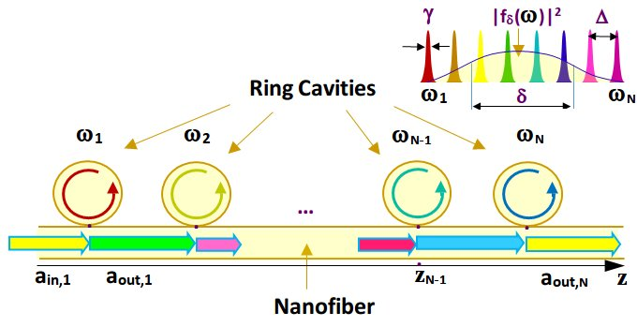
CRC-протокол
Developing broadband multi-resonator quantum memory
S. Moiseev, E. Moiseev Laser Phys. Lett. 14 (2017) 015202
Spectrum of
input signal
b₁
b₂
b_{n-1}
b_{n}
κ
κ
κ
κ

Slide 58
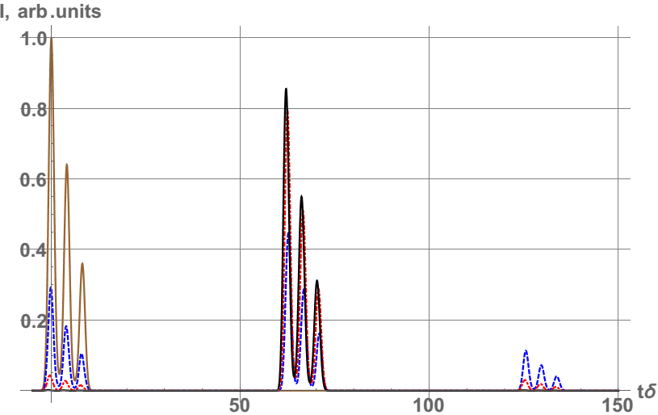
Demonstration of effective storage of three-pulse input field
Number of cavities: N = 61
Finesse: F=Δ/(2γ) = 50
Spectral width: δ=10Δ

Slide 59
Optimal coupling of ring cavity with optical waveguide (impedance matching):
κ=0.5Δ
κ=0.25Δ
κ=0.1Δ
t_{echo}≈ 60 t_{s} = δ⁻¹

Slide 60
Optimal coupling of ring cavity with optical waveguide (impedance matching):
κ=0.5Δ
Time window
for manipulation with field trapped in a system of high Q miniresonators
γ
κ
Δ
ω₁ ω_{N}
δ
(impedance matching condition): κ=0.5Δ
Cascade quantum memory

Slide 61
Towards optical and microwave quantum memories :
Multi- ring resonator scheme of QM
S. Moiseev, E. Moiseev Laser Phys. Lett. 14 (2017) 015202
κ=0.5Δ
κ=0.25Δ
κ=0.1Δ
κ
b₁
κ
b₂
κ
b_{n-1}
κ
b_{n}
t_{echo}≈ 60 t_{s} = δ⁻¹

Slide 62
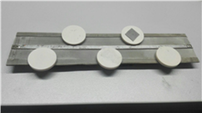
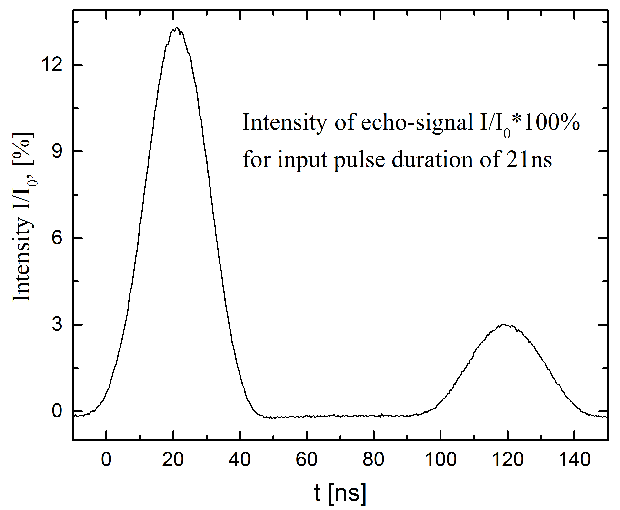
Towards optical and microwave quantum memories :
Multi- ring resonator scheme of QM
S. Moiseev, E. Moiseev Laser Phys. Lett. 14 (2017) 015202
κ=0.5Δ
κ=0.25Δ
κ=0.1Δ
κ
b₁
κ
b₂
κ
b_{n-1}
κ
b_{n}
t_{echo}≈ 60 t_{s} = δ⁻¹
First experiment:
K.V. Petrovnin, N.S. Petrovnin, O.N.Sherstukov, and S.A.Moiseev, Microwave quantum memory on controlled frequency combs, Quantum Electronics (2018, in press).
Microwave scheme
This version of memory we implemented on a system of microwave ring resonators with an efficiency of 3 %. Optical quantum memory on a system of high-quality resonators will be able to operate at room temperature with a storage time of up to 100 µs.

Slide 63
On the way to microwave multi-resonator quantum memory
Spin ensembles in microwave QED cavity:
With natural AFC spin system:
K.I. Gerasimov, S.A. Moiseev, V.I. Morosov, R.B. Zaripov, Phys. Rev. A 90(4), 042306 (2014).
Gerasimov, K.I., Moiseev, S.A. & Zaripov, R.B. Appl. Magn. Reson. 48, 795 (2017).
Multiresonator quantum memory,
Moiseev, S. A., Gubaidullin, F. F., Kirillov, R. S., Latypov, R. R., Perminov, N. S., Petrovnin, K. V., and Sherstyukov, O. N., Phys. Rev. A 95, 012338 (2017).
All-optical photon echo on a chip,
Moiseev, E. S. and Moiseev, S. A., Laser Physics Letters 14(1), 015202 (2017).
Spectral-topological superefficient quantum memory,
Perminov, N. S. and Moiseev, S. A., (2017) (sent to PRL).
Broadband multiresonator quantum memory-interface,
Moiseev, S. A., Gerasimov, K. I., Latypov, R. R., Perminov, N. S., Petrovnin, K. V., and Sherstyukov, O. N., (2017) (sent to Sci. Rep.).
Superefficient long-lived multiresonator quantum memory,
N.S. Perminov, D.Yu. Tarankova, S.A. Moiseev, (2017) (Proc. of SPIE); arxiv:1711.07014, (2017).
N.S. Perminov, D. Yu. Tarankova, S. A. Moiseev. Superefficient cascade multiresonator quantum memory Las.Phys.Lett. (2019) arXiv:1809.08759

Slide 64
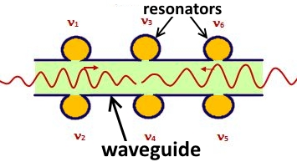


Microwave multiresonator protocol
S.A. Moiseev, F.F. Gubaidullin, R.S. Kirillov, R.R. Latypov, N.S. Perminov, K.V. Petrovnin and O.N. Sherstyukov, Multiresonator Quantum Memory, Phys.Rev.A. 95, 012338 (2017)
Periodic spatial and frequency location
z_{n} = z₀ + n λ , ν_{n} = ν₀ + n Δ
γ
κ
Δ
ω₁ ω_{N}
Light field
Light field
Bragg type impedance matching condition:
Δ=π κ/2
KQC
2 0 1 4

Slide 65
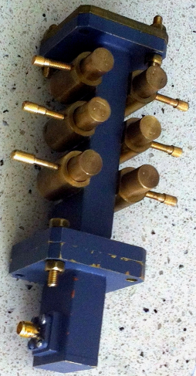
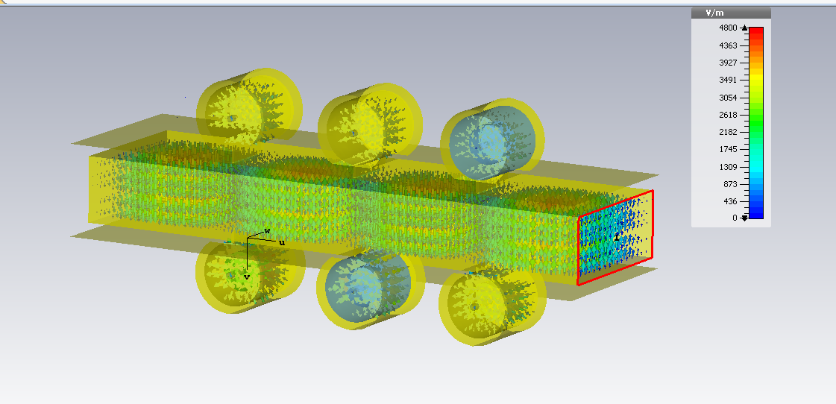
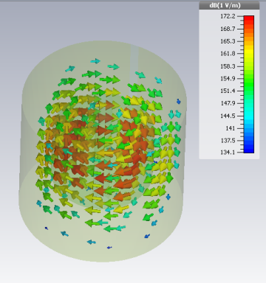
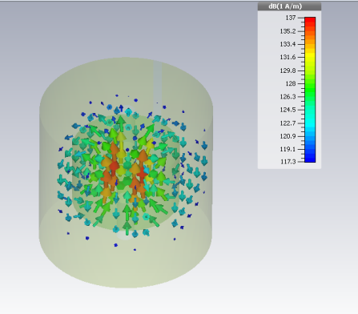
Towards mutiresonant microwave quantum memory
S. A. Moiseev, F. F. Gubaidullin, R. S. Kirillov, R. R. Latypov, N. S. Perminov, K. V. Petrovnin, and O. N. Sherstyukov, Phys. Rev. A 95, 012338 (2017)
Compact resonators (Q = 2⋅10³ )
Numerical Simulations of electromagnetic field
Tuning tools
Common resonator + 6 coupled miniresonators
L=10 cm
Single miniresonator
Common microwave waveguide (λ=3 cm)
KQC
Magnetic field Electric field
2 0 1 4

Slide 66
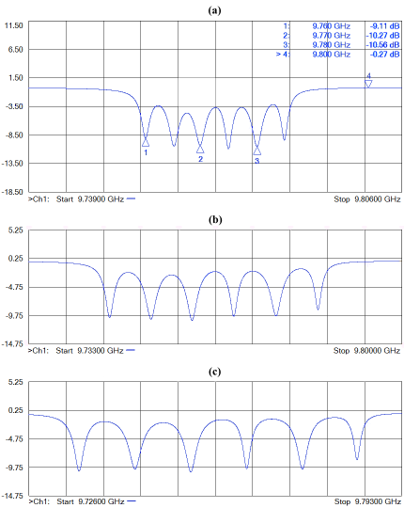
Experimental spectra of the multiresonator system
1 Mhz
5 Mhz
9.73 Ghz
T=300 K
KQC
2 0 1 4

Slide 67
S.A. Moiseev, K.I. Gerasimov, R.S. Kirillov, R.R. Latypov, N.S. Perminov, K.V. Petrovnin, O.N. Sherstyukov. “Broadband multiresonator quantum memory-interface” Scientific Reports V.8, # 3982 (2018).
Experimental normalized echo intensity
nanoseconds
KQC
2 0 1 4
Quantum Efficiency ~ 16.3 %

Slide 68
Recent experimental data on AFC microwave protocol
S.A. Moiseev, K.I. Gerasimov, R.S. Kirillov, R.R. Latypov, N.S. Perminov, K.V. Petrovnin, O.N. Sherstyukov. “Broadband multiresonator quantum memory-interface” Scientific Reports V.8, # 3982 (2018).
Experimental normalized echo intensity
Time window
for manipulation with field trapped in a system of high Q miniresonators
nanoseconds
KQC
Quantum Efficiency ~ 16.3 %
2 0 1 4

Slide 69
Recent experimental data on AFC microwave protocol
Experimental normalized echo intensity
nanoseconds
Quantum Efficiency ~ 16.3 %
KQC
2 0 1 4

Slide 70
Towards superefficient quantum memory
N.S. Perminov and S.A. Moiseev Spectral-Topological Superefficient Quantum Memory. arXiv:1706.00592
γ
κ
Δ
ω₁ ω_{N}
AFC (infinite number of combs)
in resonator
M. Afzelius and C. Simon, Phys. Rev. A, 82, 022310 (2010).
_____________________________________________________________________________________
Kazan Quantum Center, KNRTU-KAI, Russia
KQC
S.A.Moiseev
2 0 1 4

Slide 71
Towards superefficient quantum memory
N.S. Perminov and S.A. Moiseev Spectral-Topological Superefficient Quantum Memory. arXiv:1706.00592
Δ
γ
ω₁ ω₄
κ
|f_{δ}(ω)|²
ω₁ ω₄
Small number of combs (N=4)
_____________________________________________________________________________________
Kazan Quantum Center, KNRTU-KAI, Russia
KQC
S.A.Moiseev
2 0 1 4

Slide 72
Towards superefficient quantum memory
N.S. Perminov and S.A. Moiseev Spectral-Topological Superefficient Quantum Memory. arXiv:1706.00592
Δ
γ
ω₁ ω₄
κ
|f_{δ}(ω)|²
ω₁ ω₄
Small number of combs (N=4)
Squeezing of
spectral distances
due to strong coupling
with cavity mode
_____________________________________________________________________________________
Kazan Quantum Center, KNRTU-KAI, Russia
KQC
S.A.Moiseev
2 0 1 4

Slide 73
Towards superefficient quantum memory
N.S. Perminov and S.A. Moiseev Spectral-Topological Superefficient Quantum Memory. arXiv: 1706.00592
Initially periodic comb structure
Δ ±1 = = ±0.5, Δ ±2 = ±1.5,
g±1 = 0.318, g±2 = 0.318
_____________________________________________________________________________________
Kazan Quantum Center, KNRTU-KAI, Russia
KQC
S.A.Moiseev
2 0 1 4

Slide 74
Towards superefficient quantum memory
N.S. Perminov and S.A. Moiseev Spectral-Topological Superefficient Quantum Memory. arXiv: 1706.00592
Initially periodic comb structure
Δ ±1 = = ±0.5, Δ ±2 = ±1.5,
g±1 = 0.318, g±2 = 0.318
Optimized comb structure:
Δ ±1 = ±0.5, Δ ±2 = ±1.92,
g±1 = 0.318, g±2 = 1.09
the spectral errors:
_____________________________________________________________________________________
Kazan Quantum Center, KNRTU-KAI, Russia
KQC
S.A.Moiseev
2 0 1 4

Slide 75
Towards superefficient quantum memory
N.S. Perminov and S.A. Moiseev Spectral-Topological Superefficient Quantum Memory. arXiv: 1706.00592
Δ
γ
Initial spectral comb structure:
ω₁ ω₄
1.42Δ
1.42Δ
_____________________________________________________________________________________
Kazan Quantum Center, KNRTU-KAI, Russia
KQC
S.A.Moiseev
2 0 1 4

Slide 76
Towards superefficient quantum memory
N.S. Perminov and S.A. Moiseev Spectral-Topological Superefficient Quantum Memory. arXiv: 1706.00592,
Δ
γ
Initial spectral comb structure:
ω₁ ω₄
1.42Δ
1.42Δ
Periodic final spectral comb structure:
|f_{δ}(ω)|²
ω₁ ω₄
Δ
_____________________________________________________________________________________
Kazan Quantum Center, KNRTU-KAI, Russia
KQC
S.A.Moiseev
2 0 1 4

Slide 77
Towards superefficient quantum memory
N.S. Perminov and S.A. Moiseev Spectral-Topological Superefficient Quantum Memory. arXiv: 1706.00592,
Δ
γ
Initial spectral comb structure:
ω₁ ω₄
1.42Δ
1.42Δ
Periodic final spectral comb structure:
|f_{δ}(ω)|²
ω₁ ω₄
Δ
_____________________________________________________________________________________
Kazan Quantum Center, KNRTU-KAI, Russia
KQC
S.A.Moiseev
2 0 1 4

Slide 78
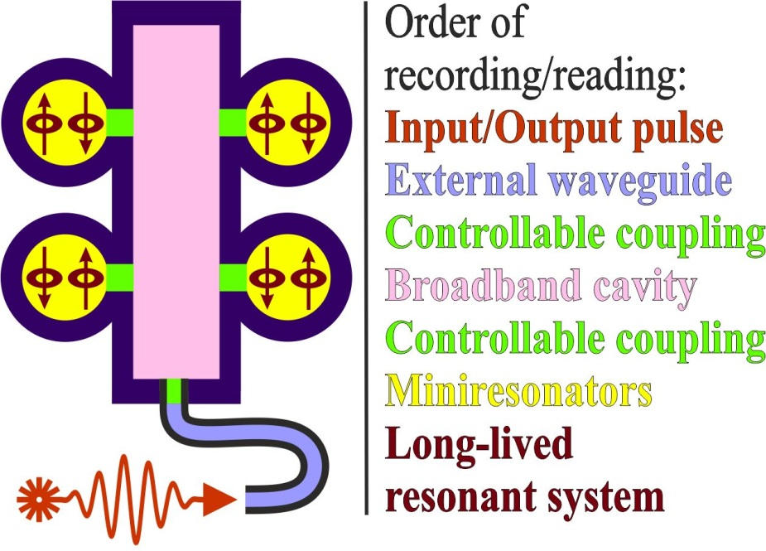
Towards long-lived superefficient quantum memory
N.S. Perminov, D.Yu. Tarankova, and S.A. Moiseev, Superefficient long-lived multiresonator quantum memory arxiv:1711.07014, (2017) .
Principal scheme of a
hybrid MR QM

Slide 79
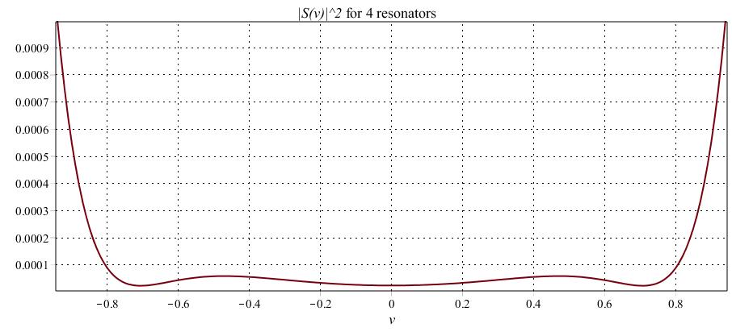
Towards long-lived superefficient quantum memory
N.S. Perminov, D.Yu. Tarankova, and S.A. Moiseev, Superefficient long-lived multiresonator quantum memory arxiv:1711.07014, (2017) .
Principal scheme of a
hybrid MR QM
Typical transmission spectra of HMR QM (recording stage) after
spectral-topological optimization in wide frequency band

Slide 80
Towards long-lived superefficient quantum memory
N.S. Perminov, D.Yu. Tarankova, and S.A. Moiseev, Superefficient long-lived multiresonator quantum memory arxiv:1711.07014, (2017) .
Principal scheme of a
hybrid MR QM
Typical transmission spectra of HMR QM (recording stage) after
spectral-topological optimization in wide frequency band
[1] We have shown that the broadband input signal is almost completely absorbed by several spin ensembles (with an inhomogeneous broadening less than the width of the signal field) with different central frequencies forming a comb.
[2] The efficiency of the transfer of the signal field to the spin system can reach 99.99% even under weak limitations for the parameters of energy losses within the multiresonator system.
[3] Proposed scheme is universal and can be used to combine several different types of QM devices into a single wideband QM block with a higher quality spectral profile.

Slide 81
N.S. Perminov, D. Yu. Tarankova, and S. A. Moiseev. Superefficient cascade multiresonator quantum memory Las. Phys. Lett (2018 in press) arXiv:1809.08759

Slide 82

Выводы
О квантовой памяти на фотонном эхе
КП на фотонном эхо в резонаторе облегает возможность достижения высокой квантовой эффективности и реализации адресной памяти.
Экспериментально продемонстрирована реализация КП на фотонном эхе с естественным неоднородным уширением линии с эффективностью 13.6 %, также продемонстрировано сохранение до 10 световых импульсов, возможность запоминания фаз каждого импульса и возможность селективного восстановления отдельных импульсов, реализована КП на фотонном эхе в резонаторе с квантовой эффективностью 21 %. Полученные результаты позволяют сделать вывод о возможности реализации квантовой эффективности > 60 % в этой е схеме при использовании лучшего кристалла и более точной настройки оптического резонатора.
Выполнены первые эксперименты по фотонному эху в волноводе, сформированном внутри объема кристалла с редкоземельными ионами туллия. Эксперименты продемонстрировали технологические возможности для создания квантовой памяти на таких волноводных кристаллах.
Эксперименты по фотонному эху на кристаллах с редкоземельными ионами указывают на реальные перспективы создания высокоэффективной многомодовой КП, которая может быть использована для создания оптических квантовых репитеров.
______________________________________________________________________________
Казанский Квантовый Центр, КНИТУ-КАИ, Казань, Россия С.А. Моисеев

Slide 83
Выводы
О многорезонаторной (МР) квантовой памяти
Системы резонаторов открывают путь в создании высоэффективного интерфейса для сохранения широкополосных световых полей.
Есть возможность создания МР КП в оптическом и микроволновом спектральном диапазоне (последняя продемонстрировала интересные перспективы для достижения высокой квантовой эффективности).
МР схема может обеспечить сверхэффективное сохранение квантового сигнала, что представляется возможным для экспериментальной реализации в условиях, характерных для работы сверхпроводящего квантового компьютера.
Показана возможность реализации долгоживущей МР КП при дополнительном использовании ансамбля спинов в системе минирезонаторов.
______________________________________________________________________________
Казанский Квантовый Центр, КНИТУ-КАИ, Казань, Россия С.А. Моисеев

Slide 84


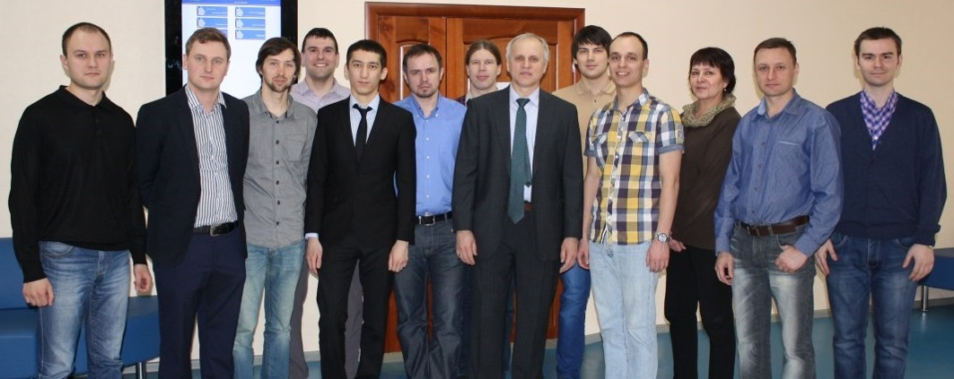
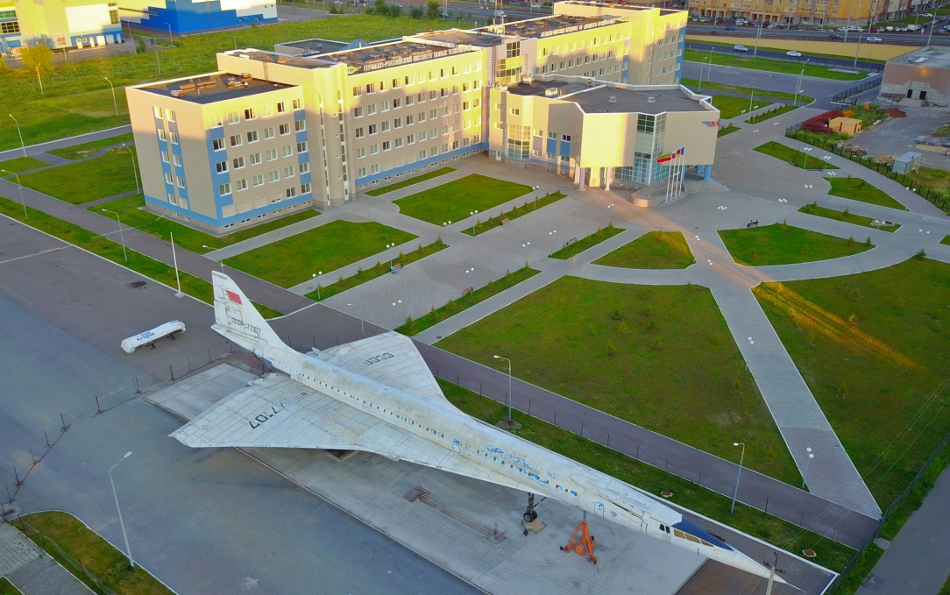


Казанский Квантовый Центр,
Казанский Национальный Исследовательский
Технический Университет им. А.Н. Туполева,
Четаева 18а, Казань, Россия
Лаборатории ККЦ КНИТУ-КАИ:
Квантовой памяти (С.А. Моиссеев)
Фотоники и квантовых технологий (А.М. Желтиков)
Квантовых коммуникаций (А.В. Глейм)
Грант правительства РФ № 14.Z50.31.0040, 17.02.2017
№ 14-12-01333 П
http:/kazanqc.org

Slide 85
Kazan
Thank you for your attention !

Slide 86
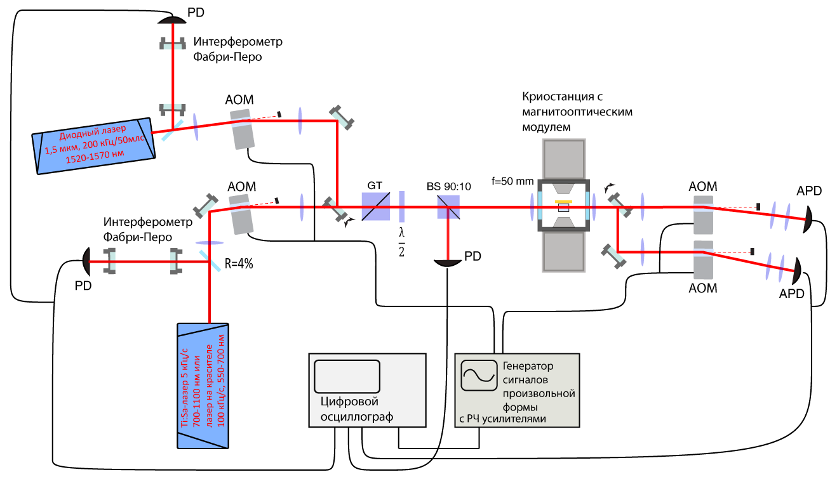
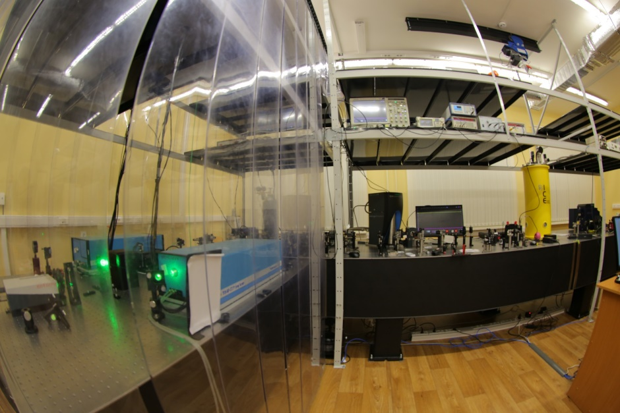
KQC
На пути к реализации оптической квантовой памяти на фотонном эхе в резонаторе
на нерезонансных рамановских переходах в твердом теле
2 0 1 4
Схема установки по наблюдению фотонного эха, 2015 год. Квантовый центр КНИТУ-КАИ
Stabilized lasers for visible spectral range
Optical cryostat, Temperature > 1.3 K
Optical cryostat, Temperature >3.7 K
Рис. 1. Схема установки для наблюдения фотонного эха для двух диапазонов длин волн. PD – фотодетектор; APD – лавинный фотодиод; GT – поляризатор Глана-Тейлора; BS – делитель пучка; AOM – акустооптический модулятор; стрелками показаны откидные зеркала. Управление акустооптическими модуляторами осуществляется при помощи генератора сигналов произвольной формы. Регистрация сигналов осуществляется цифровым осциллографом с частотной полосой пропускания 1 ГГц. Источниками излучения служат одночастотные лазеры. Стол над лазерами помещен в локальную систему очистки воздуха..

