Slide 1
OLED technology explained
Alexey Osipov
2018

Slide 2
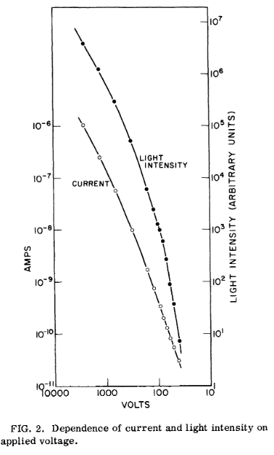
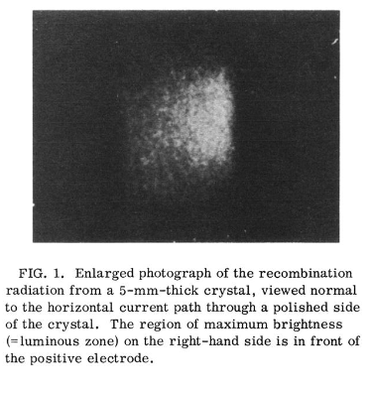
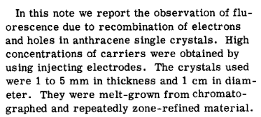
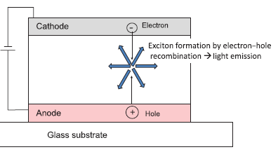
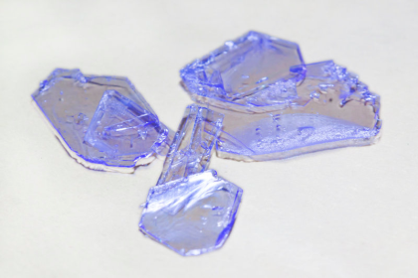
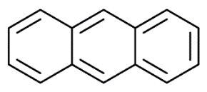
Electroluminescence
T_{m} = 215.76 °C
W.Helfrich & W.G. Sneider Phys. Rev. Lett. 14(7), 229 (1965) // ‎Cited 725 times

Slide 3
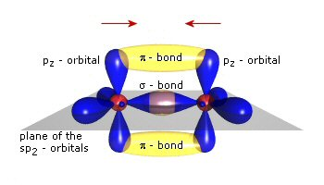
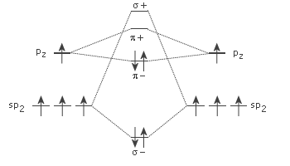
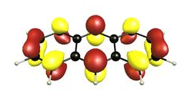
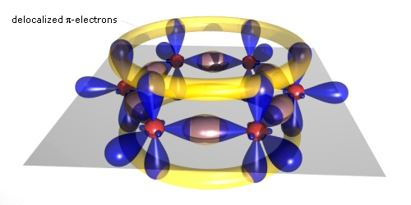
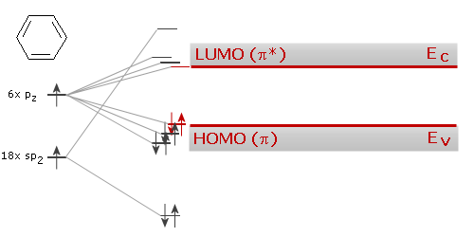
Organic semiconductors
https://www.iapp.de/orgworld.de/?Basics:What_are_organic_semiconductors

Slide 4
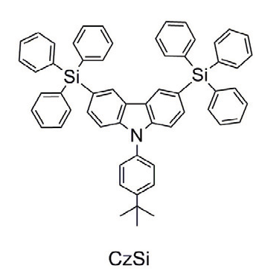
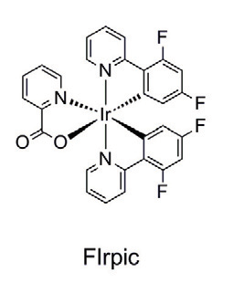
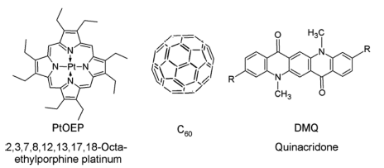
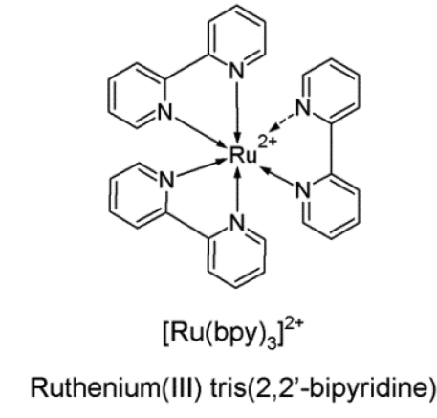
OLED Materials

Slide 5
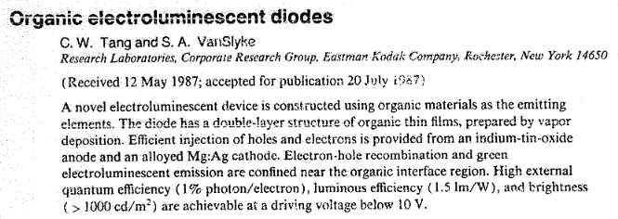
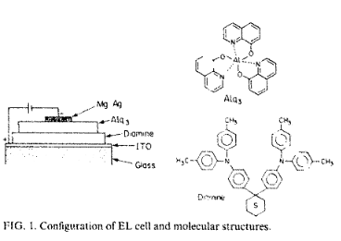
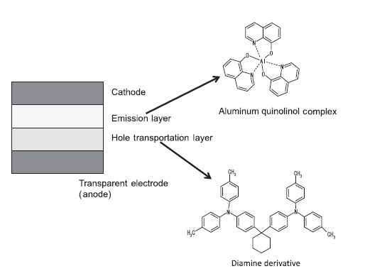
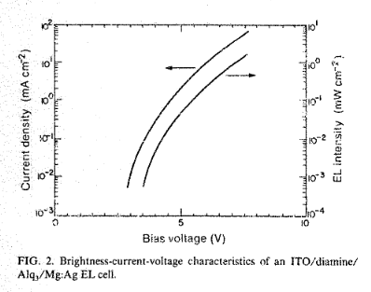
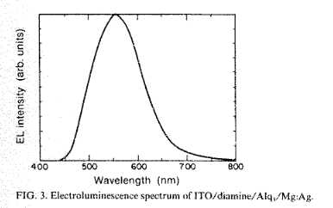
First working device
Tang and S.A. VanSlyke Appl. Phys. Lett. 51, 913(1987) // ‎Cited 14146!

Slide 6
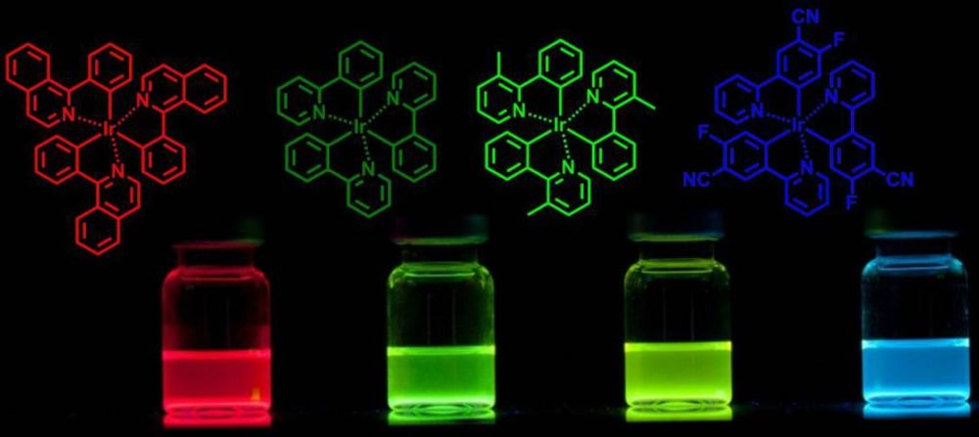
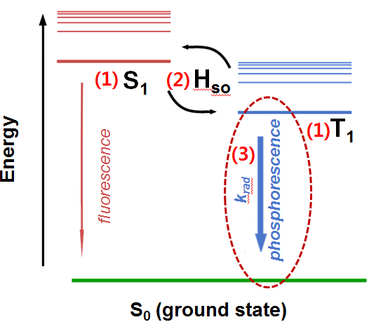
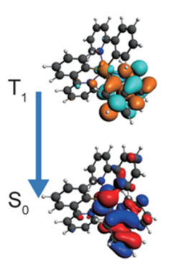
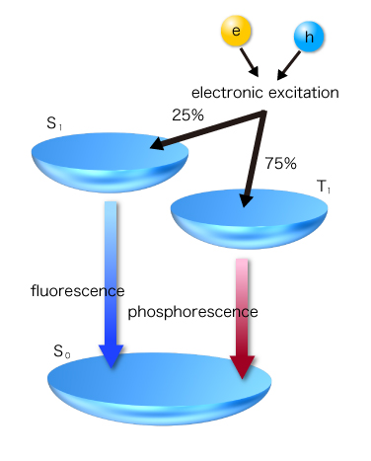
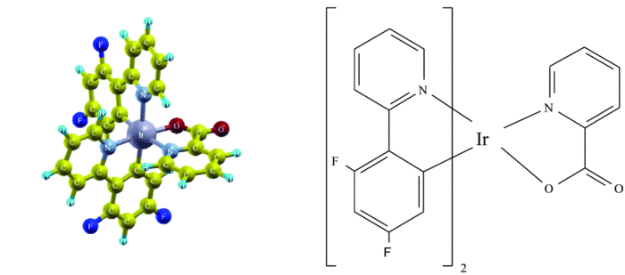
Phosphorescent OLED
UDC: 2013
PhOLED - 100% internal quantum efficiency!

Slide 7
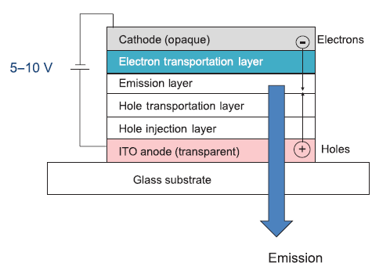
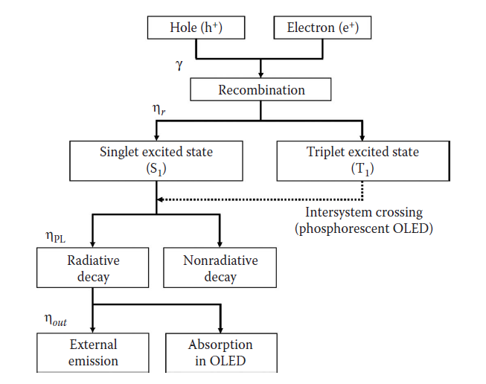
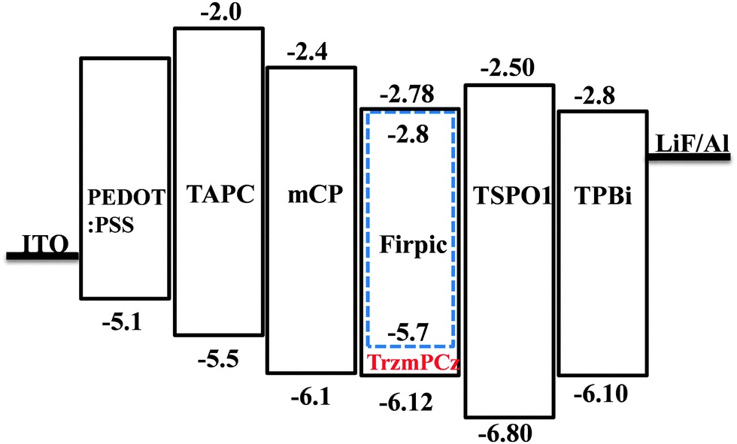
Multilayer OLED: principle and fabrication

Slide 8
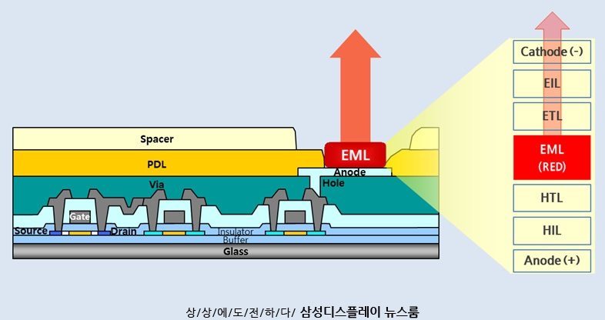
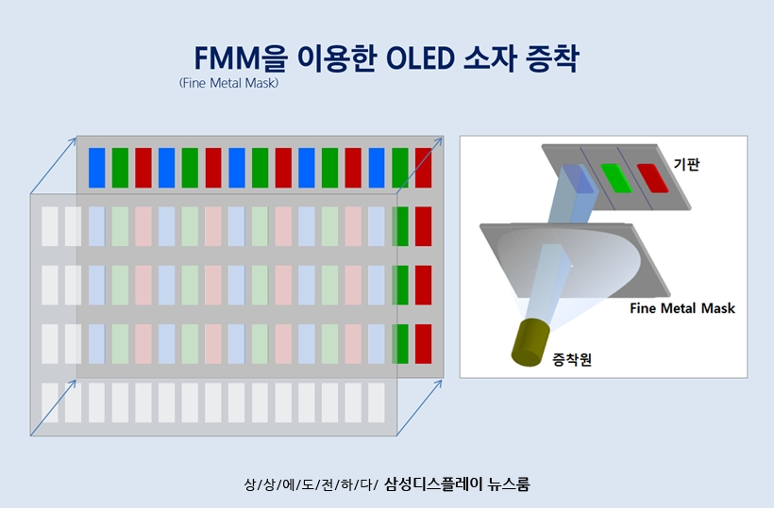
Displays: structure and fabrication

Slide 9
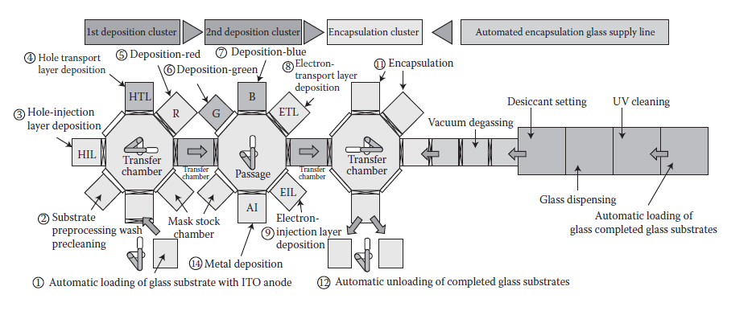
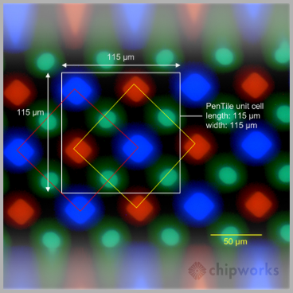
Fabrication
http://www.aixtron.com/; http://www.canon-tokki.co.jp/eng/product/el/mass.html;
http://www.oled.at/galaxy-s5-oled-pixelstruktur-doch-anders-als-beim-s4/

Slide 10
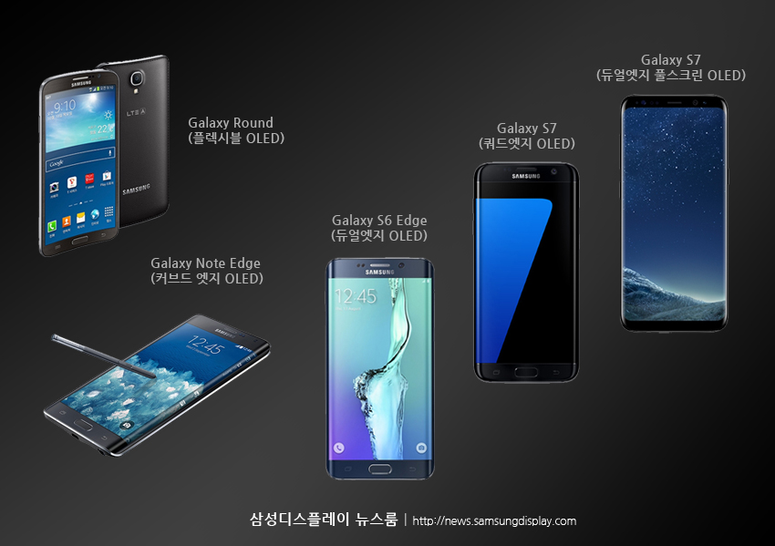
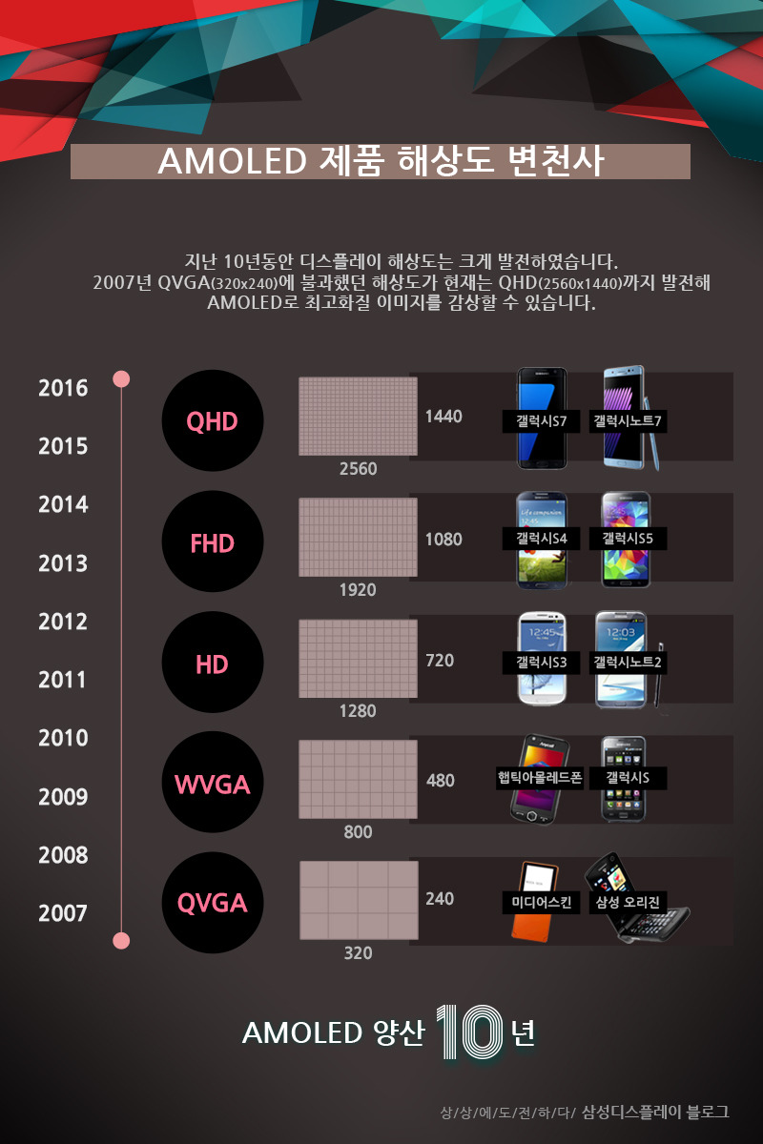
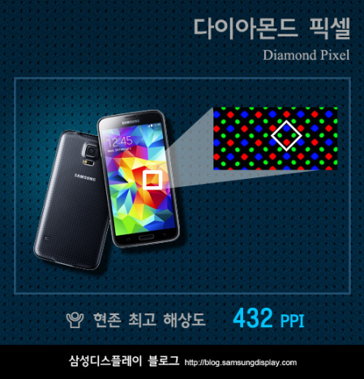
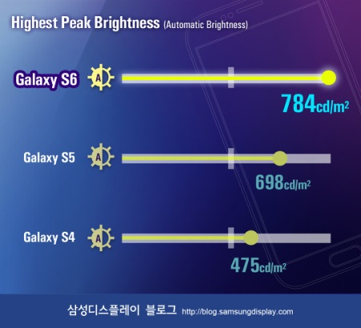
OLED displays progress
http://blog.samsungdisplay.com/731

Slide 11
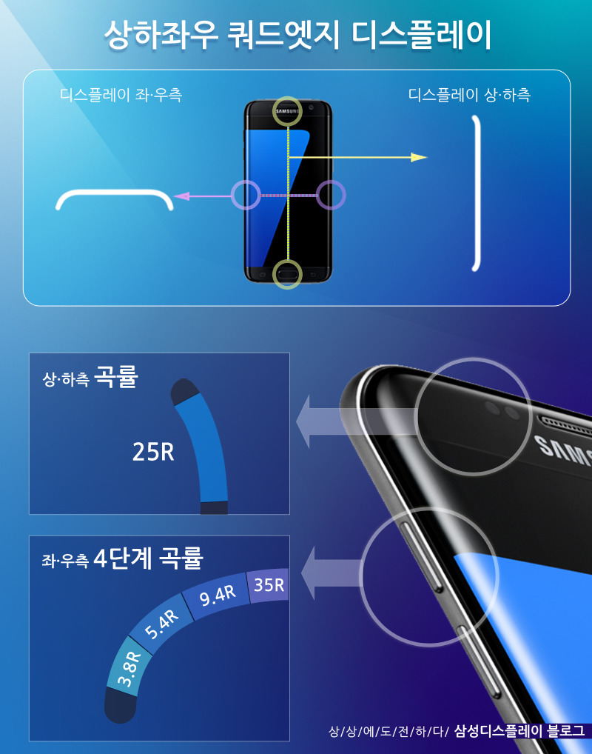
Why Edge?
http://news.samsungdisplay.com/998

Slide 12
Future of OLED displays
http://blog.samsungdisplay.com/

Slide 13
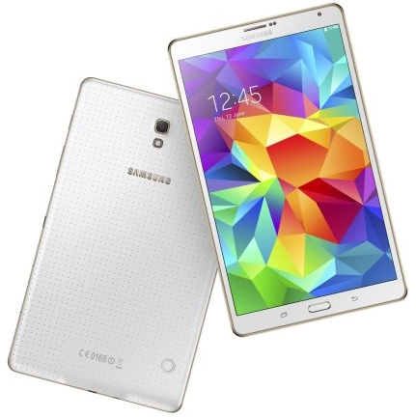
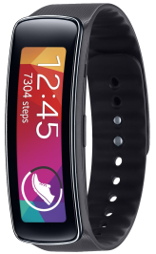
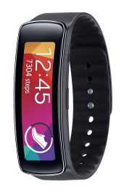
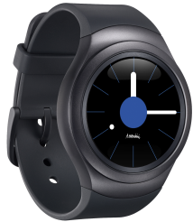
CS in new materials development
OLED is the differentiating technology of SEC, however, there are still issues related to patents coverage, efficiency and lifespan.
Computer simulations in new materials development cycle allows one to reduce TAT and costs of new material discovery process.
Contribution to Business
Develop new patent-free OLED materials – reduce expenses on royalty payments
Reduce TAT and cost of new OLED materials development cycle
Development of new OLED materials for devices with enhanced efficiency, and extended lifespan
OLED products of SEC
*UDC – Universal Display Company,
major OLED patents holder
https://www.youtube.com/watch?v=QhAFN2YpIXQ

