Slide 1
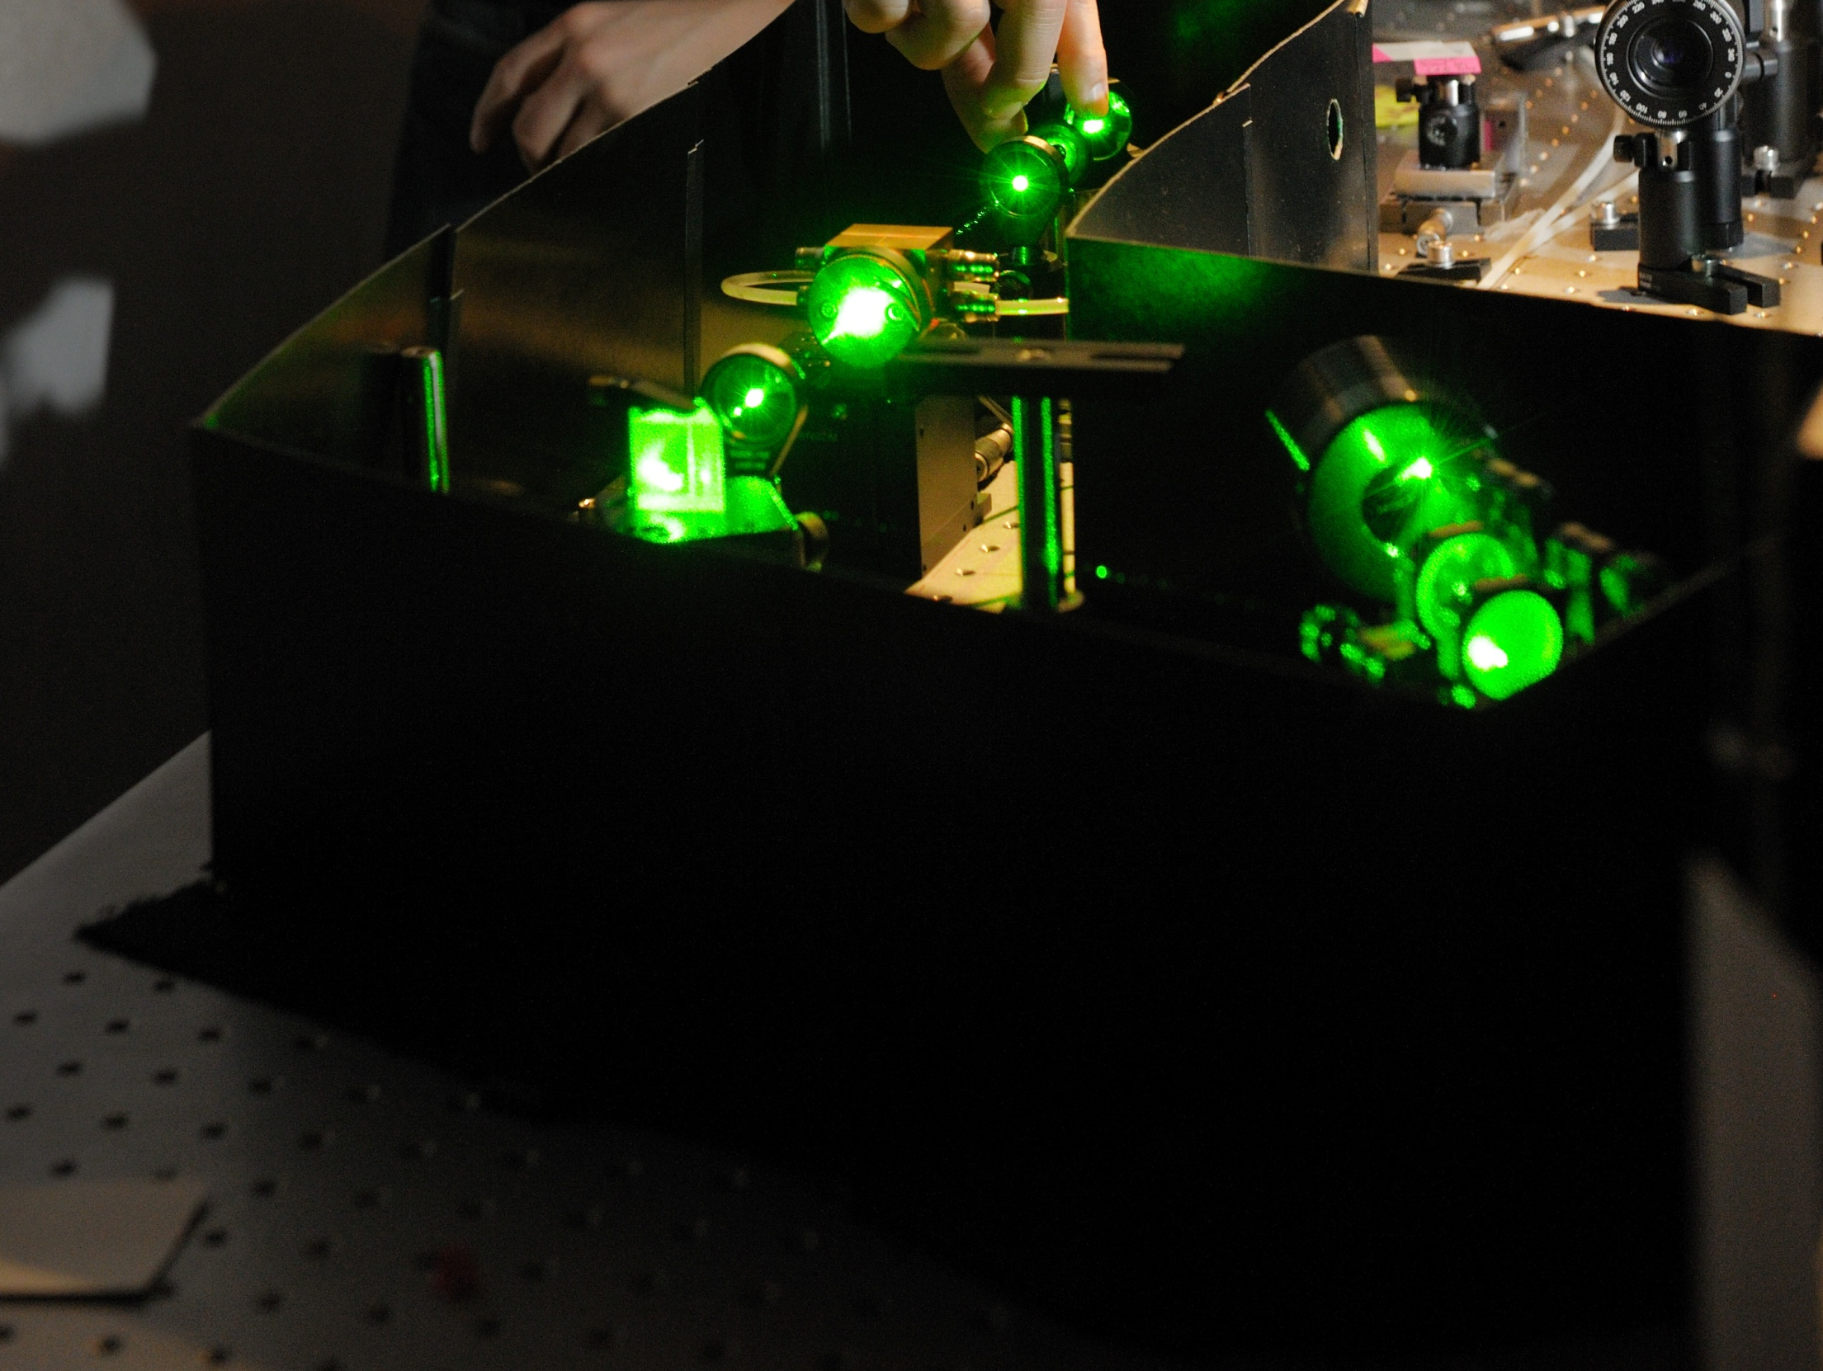

Entangled Photons for Quantum Metrology and Quantum Imaging
A. Stefanov
05.12.2018 MSU

Slide 2
Outline
Quantum Imaging
Broadband entangled photons
Outlook
Toward spectroscopy with entangled photons
Notes:
1 m

Slide 3
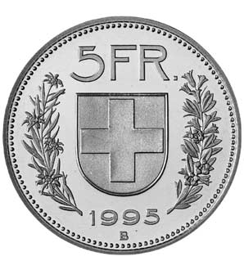

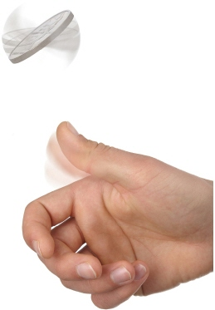
Entanglement
Non-classical (non-local) correlations
Described by a non-separable quantum states
Consequence of linearity of Quantum Mechanics
Notes:
1 m

Slide 4


Entanglement
Assume QM is correct and complete, what does an entangled state mean?
The polarization state of each photon is not defined before the measurement.
The results of the polarization measurements are always correlated instantaneously at the moment of the measurement

Slide 5
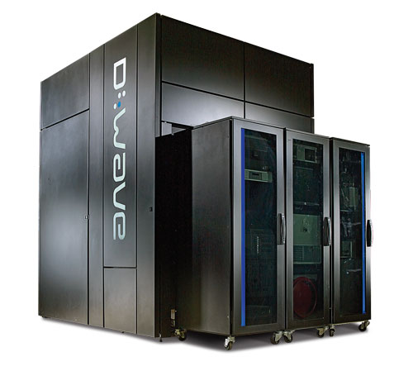
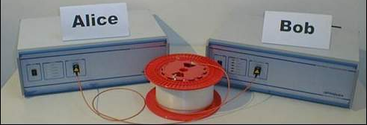
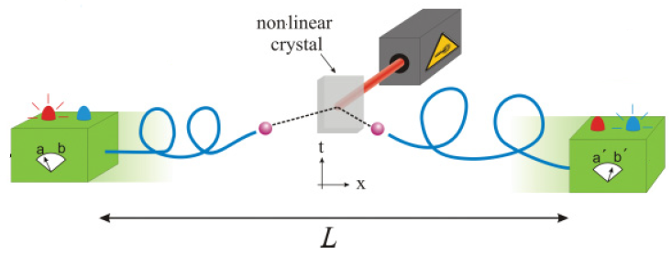
Entanglement as a ressource
To perform tasks impossible classically
Quantum computation
Quantum communication
Fundamental tests of quantum mechanics
  Non-locality of Nature (Bell tests)
  …
Quantum Metrology
Notes:
1 m

Slide 6
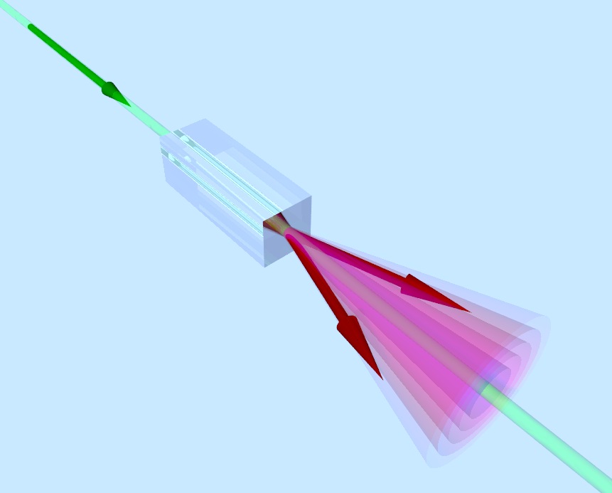

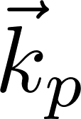
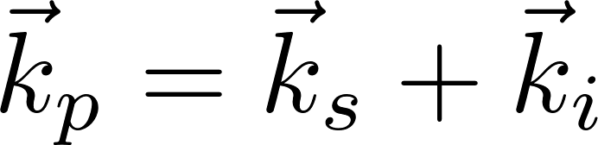
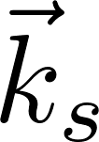




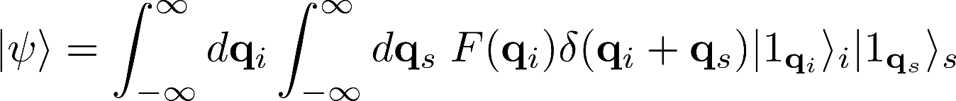
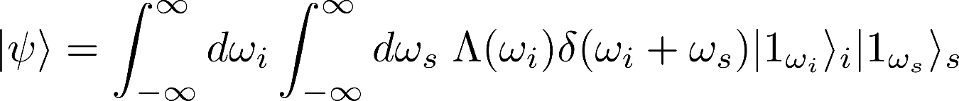
Parametric downconversion (SPDC)
  Conservation of
    Momentum
    Energy
Broadband SPDC emission Entanglement in:
Transverse momentum
Energy-time entanglement
Imaging
  TOF/Dispersion
  OCT
  Spectroscopy

Slide 7
Imaging and Resolution
Classical imaging:
Resolution confined by the Rayleigh limit
Sub-Rayleigh quantum imaging:
Non-classical light sources and N-fold coincidence detection between N photons M. Genovese, J. Opt. 18, 073002 (2016)
Standard Quantum Limit (SQL): Heisenberg Limit (HL):
V. Giovannetti et al., PRA 79, 013827 (2009)
NOON states allow for improved resolution in interference patterns:
We use OCM for quantum imaging of 2D objects at the Heisenberg limit
NOON state interference
+ Optical Centroid Measurement (OCM)
Shin et al., PRL 107, 083603 (2011)
Rozema et al., PRL 112, 223602 (2014)
Edamatsu et al., PRL 89, 213601 (2002)
M. Unternährer et al., Optica 5, 1150-1154 (2018)

Slide 8
Sensor: SuperEllen
SuperEllen - A time resolving single photon detector array in CMOS technology (FBK)
Sensor
Process technology | CMOS (150 nm)
Array size | 32 x 32 pixels
Pixel pitch | 44.6 µm
In-pixel photodetectors | 1 SPAD per pixel
Chip size | 1.7 x 1.9 mm²
Pixel fill factor FF | 19.48%
Max. frame rate | 800kHz
Per Pixel Time-to-Digital Converter (TDC)
Resolution | (204.5± 2.7) ps
Single Photon Avalanche Diodes (SPADs)
Avg. dark count rate | <1 kHz
Detection efficiency (including FF) | 5% @ 400 nm 0.8% @ 810 nm
L. Gasparini et al., IEEE-ISSCC, 98-100 (2018)

Slide 9
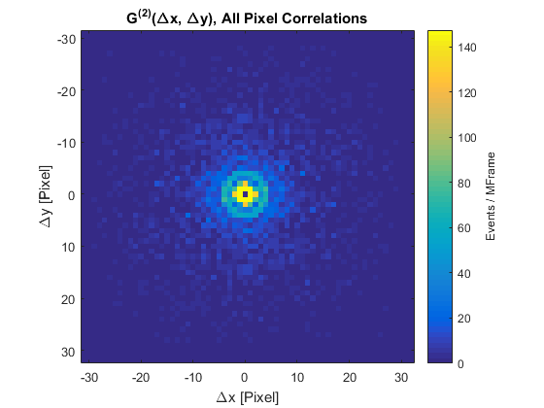
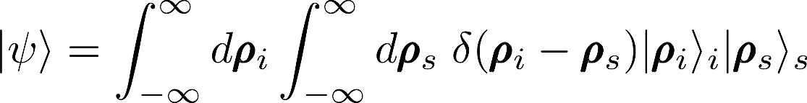
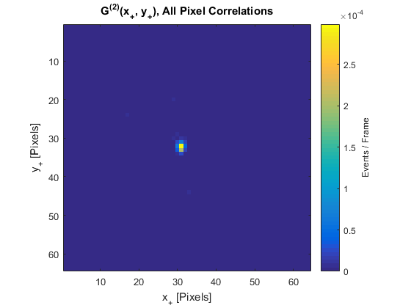
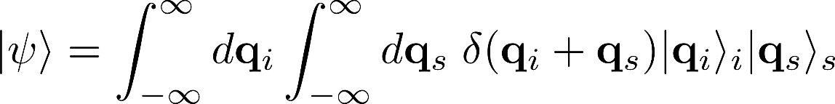
Near and Far Field correlations
Near field
f = 60 mm
400nm
PPKTP
SuperEllen
85mm
200mm
Far field
f = 40mm
400nm
PPKTP
SuperEllen
f
f

Slide 10
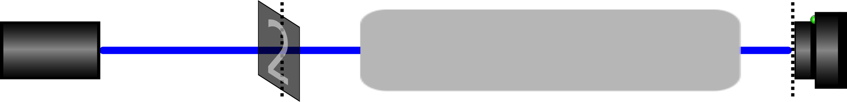
Classical Coherent Imaging
Σ_{o}
Σ_{i}
Field intensity in the image plane
: Shift invariant point-spread function (PSF) specific to an optical system
The finite width of the PSF determines the resolution of the optical system
Laser
: Magnification factor

Slide 11

OCM quantum imaging
Optical Centroid Measurement (OCM)
Replace the classical field distribution at by an N-photon entangled state
Optical Centroid
Measure a spatially resolved N-order correlation function
M. Tsang, PRL 102, 253601 (2009)
Σ_{o}
Σ_{o}
Σ_{i}
OCM state preparation
Laser
OCM state:

Slide 12
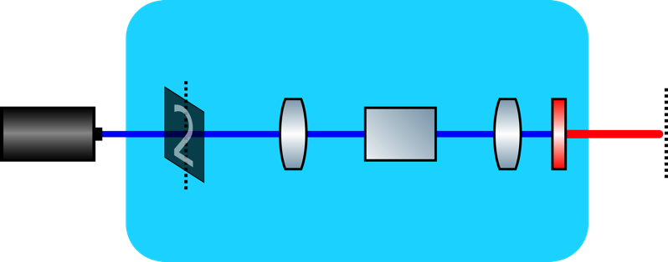
Experiment
Setup
An object is illuminated (405 nm) and imaged in a 4-f setup from to
Far-field plane: Non-linear crystal for type-0 SPDC
Spatially entangled 2-photon states at 810 nm
At we (almost) have the desired OCM state for N=2:
Σ’_{o}
Σ_{o}
OCM state preparation
Laser
L₁
NLC
L₂
BP
Σ’_{o}
Σ_{o}
Σ_{o}
for 200 x 300 µm² (object size)

Slide 13
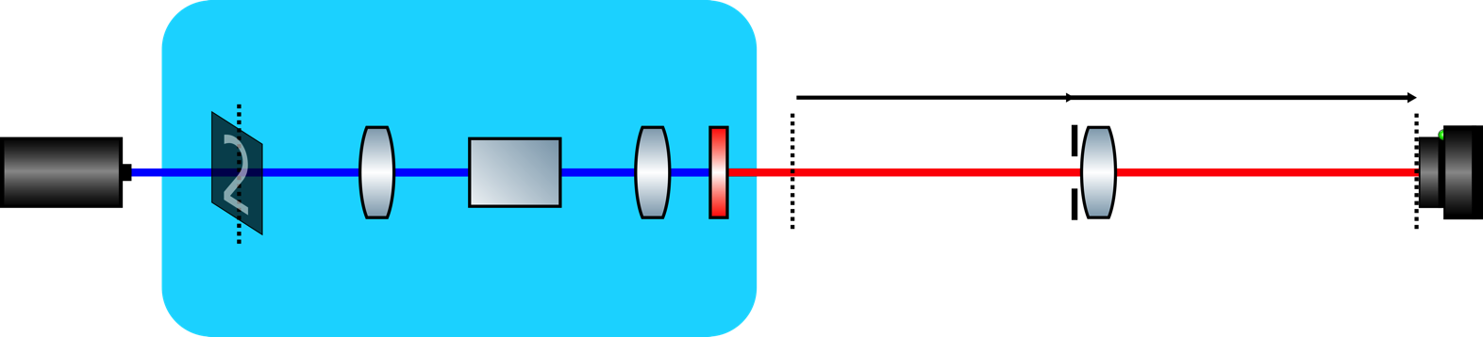
Experiment
Σ’_{o}
Σ_{o}
Σ_{i}
OCM state preparation
s_{o}
s_{i}
Laser
NLC
BP
L₃
L₁
L₂
L₃
Σ_{o}
Σ_{i}
Single-lens imaging system from to with magnification factor
Variable size iris allows to modify the numerical aperture (resolution) of the imaging system
The PSF for classical coherent and OCM quantum imaging are given by:
Classical coherent: OCM:
Heisenberg limit

Slide 14
Results
OCM quantum imaging vs. classical imaging
The PSF is compared for 810 nm OCM, 810 nm and 405 nm classical imaging
Imaging of a point source at (focused laser beam with 25 μm Gaussian waist)
The numerical aperture of the imaging system is small (0.0016)
Σ’_{o}
SQL
HL

Slide 15
Results
OCM quantum imaging vs. classical imaging
Imaging of a 200 x 300 μm2 object
The image is compared for 810 nm OCM, 810 nm and 405 nm classical imaging
Classical 810 nm
OCM 810 nm
Classical 405 nm
Image encoded in centroid position:
63 x 63 pixels
M. Unternährer et al., Optica 5, 1150-1154 (2018)

Slide 16
OCM Intuition
OCM 2-photon entangled state in the far-field shows strong position correlations
and
The imaging lens is placed in the far-field of the object plane
Lens pupil:
At the position of the lens, the two photons behave like a single photon with half the wavelength
This mimics one photon at the de Broglie wavelength with a corresponding PSF
Multi-mode NOON state for N=2
FF
Σ_{o}

Slide 17












SUPERTWIN
All Solid-State Super-Twinning Photon Microscope
PROJECT ID: 686731
www.supertwin.eu

Slide 18
Outline
Quantum Imaging
Broadband entangled photons
Outlook
Toward spectroscopy with entangled photons
Notes:
1 m

Slide 19
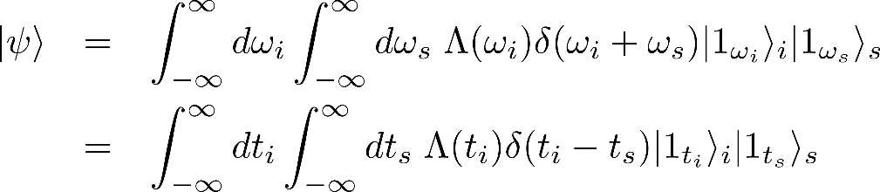
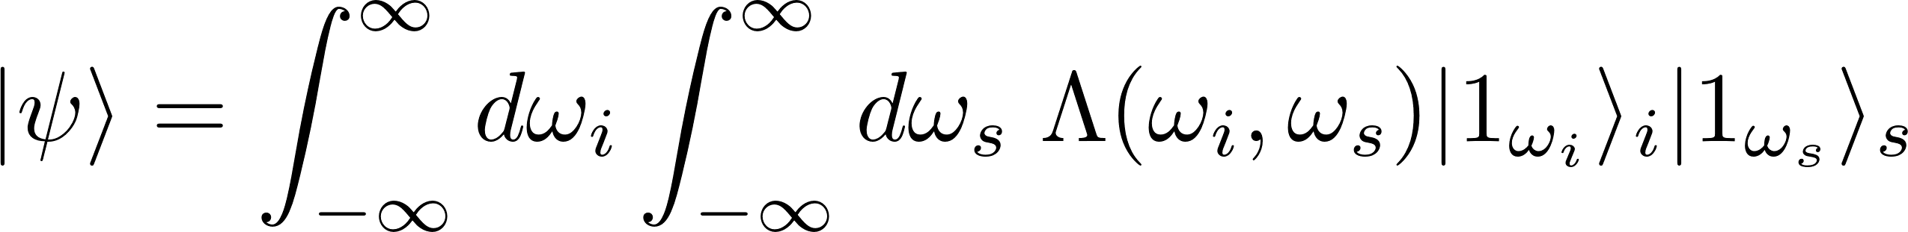
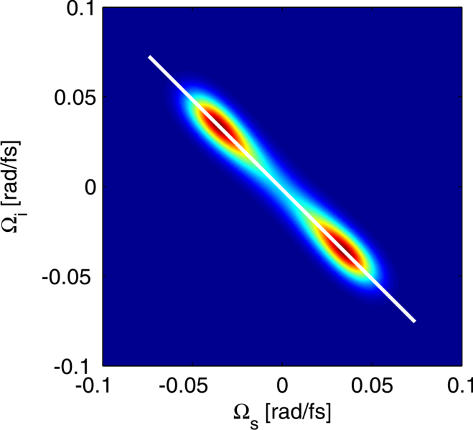
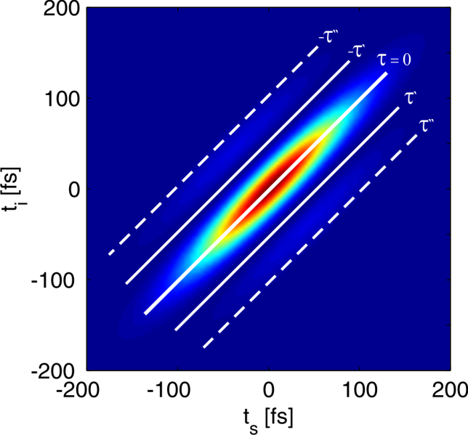
Broadband energy-entangled photons
Combine high temporal resolution with high energy resolution
Classical light
Entangled light
In general
Join spectral amplitude Join temporal amplitude

Slide 20
Combing Quantum with Ultrafast Optics
Quantum Information Theory
Methods
Quantum optics
Quantum effects in light
Wave particle duality
Entanglement
Ultrafast optics
Study of ultrafast (fs) processes by optical means
Quantum metrology
Quantum Spectroscopy

Slide 21
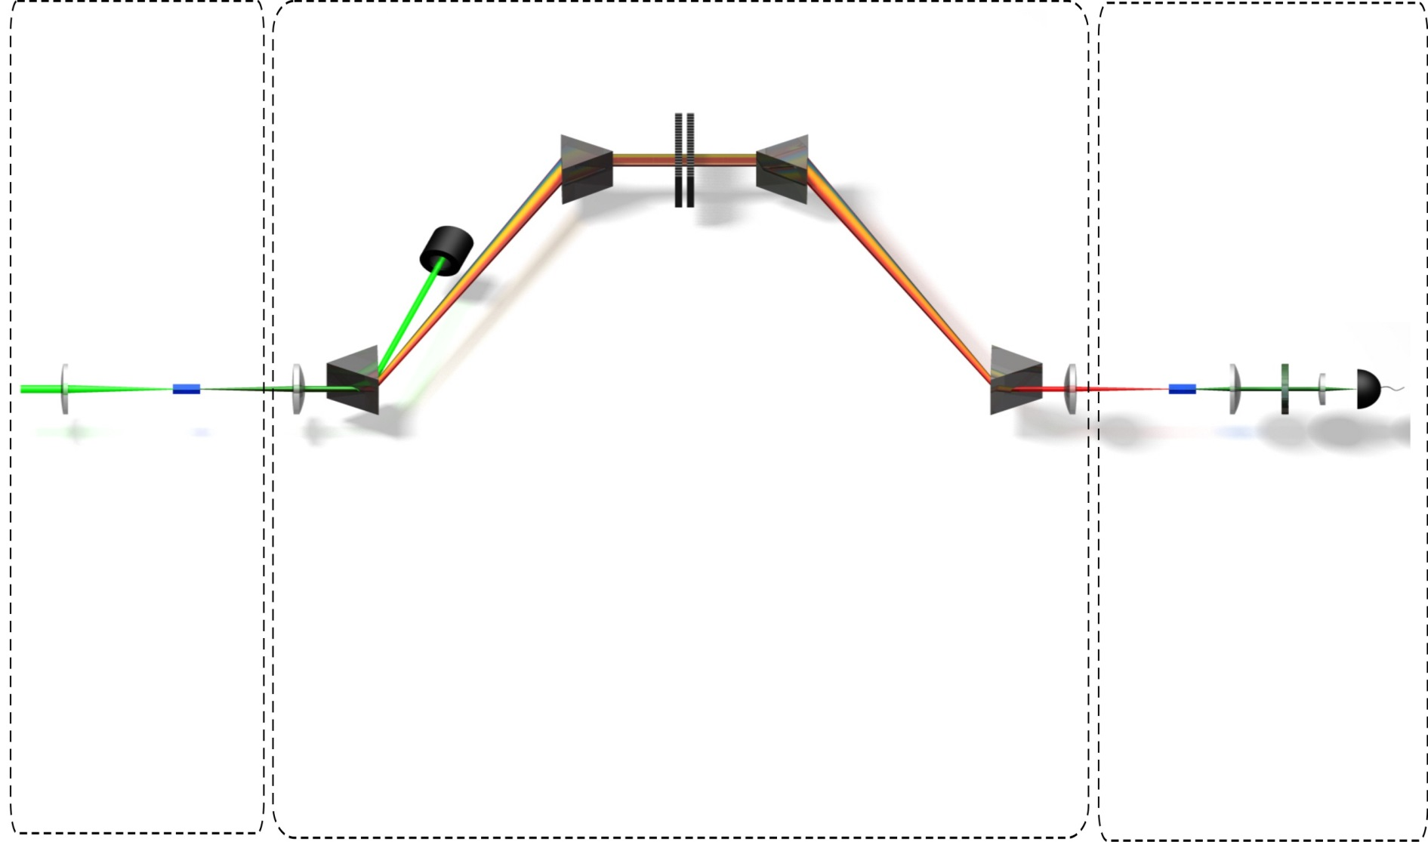

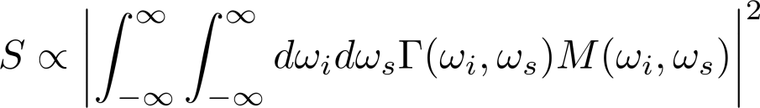

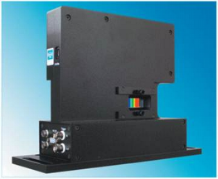

Experimental Setup
Preparation
(SPDC)
Manipulation
Detection
(SFG)
Beam dump
Spatial light modulator
(SLM)
Bandpass
filter
532 nm
PPKTP
SPCM
PPKTP
Detected signal after the SFG process:
4-prism compressor:
    Compensate for dispersion
    Align the spectrum
5 W pump laser
Sensitive to a phase in the SLM transfer
function
Jenoptik S640d
    Complex transfer function:
1064 nm
1 µW
A. Pe’er, B. Dayan, A. A. Friesem, and Y. Silberberg, Phys. Rev. Lett. 94, 073601 (2005)
F. Zäh, M. Halder, and T. Feurer, Optics Express 16, 16452-16458 (2008)
600 s⁻¹ up-converted
photons
1
Notes:
The entangled photons are then imaged with a single lense form the center of the SPDC crystal to the symmety axis of a four-prims compressor where the residue of the pump is distracted by a beam dump
The four prism compressor has two goals …

Slide 22
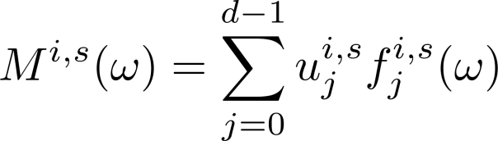
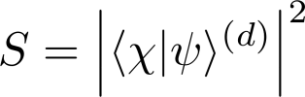
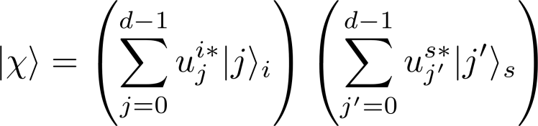
Frequency-bins
Using the transfer function
Maximally entangled qutrit
In general
Measured signal: projective measurement

Slide 23
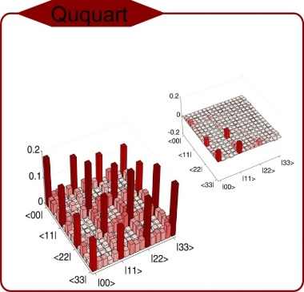


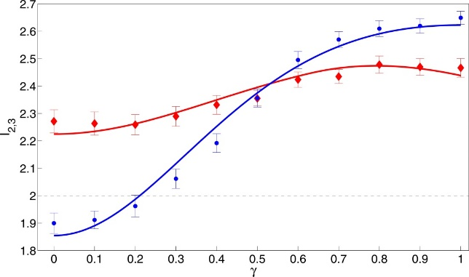
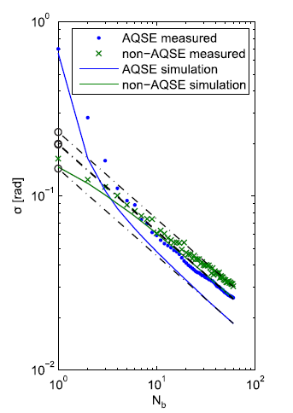
Quantum Information Processing
High dimensional entangled states (qudits)
B. Bessire, et al., NJP, 16(3), 033017 (2014).
Quantum state tomography
C. Bernhard, et al., PRA, 88(3), 032322 (2013).
Bell inequalities
C. Bernhard, et al., JPA, 47(42), 424013 (2014) .
S. Schwarz, et al., IJQI, 12, 1560026 (2015) .
S. Schwarz, et al. , New J. Phys. 18, 35001 (2016).
S. Schwarz, et al. , Phys. Rev. A 94, 22322 (2016).
Adaptive measurements
S. Lerch & A. Stefanov Optics Letters, 39(18), 5399 (2014).

Slide 24
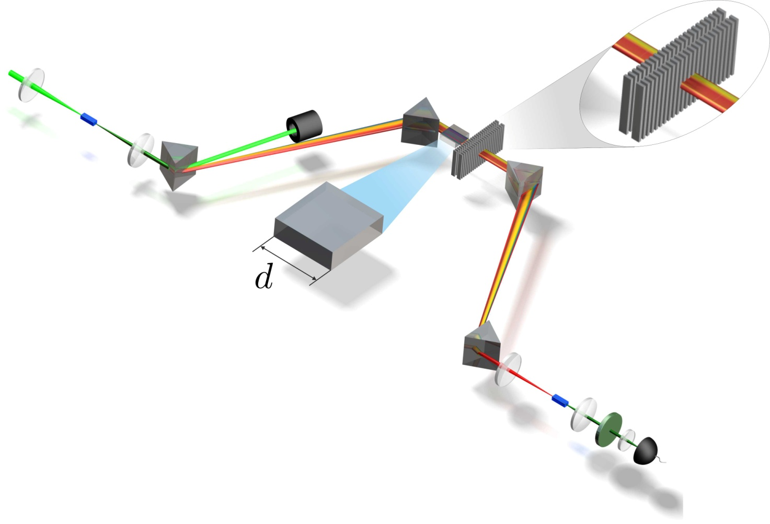
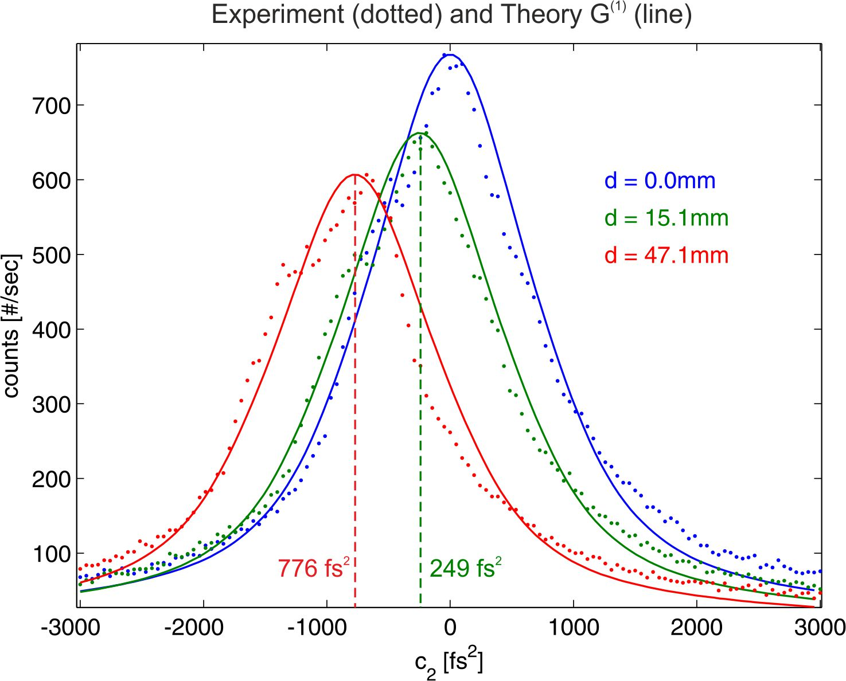
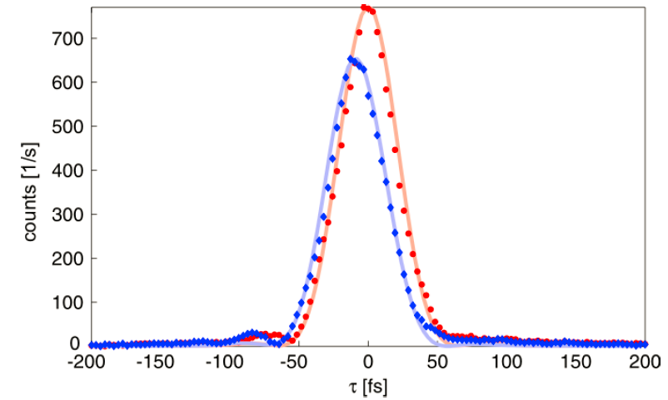
Sensitivity to dispersion
Two photon correlation function |Ψ(t)|²
  Fourier transform of Γ(ω)
  Propagates like a fs pulse
  … but CW
  Non-local dispersion cancellation

Slide 25
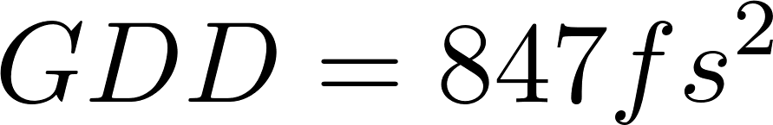
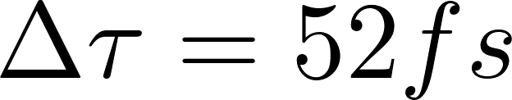
Fibers propagation
Dispersion of a 36mm single mode fiber
Delay between H and V modes of a 48mm PM fiber
J. Kohn, F. Schefold, AS, in preparation

Slide 26
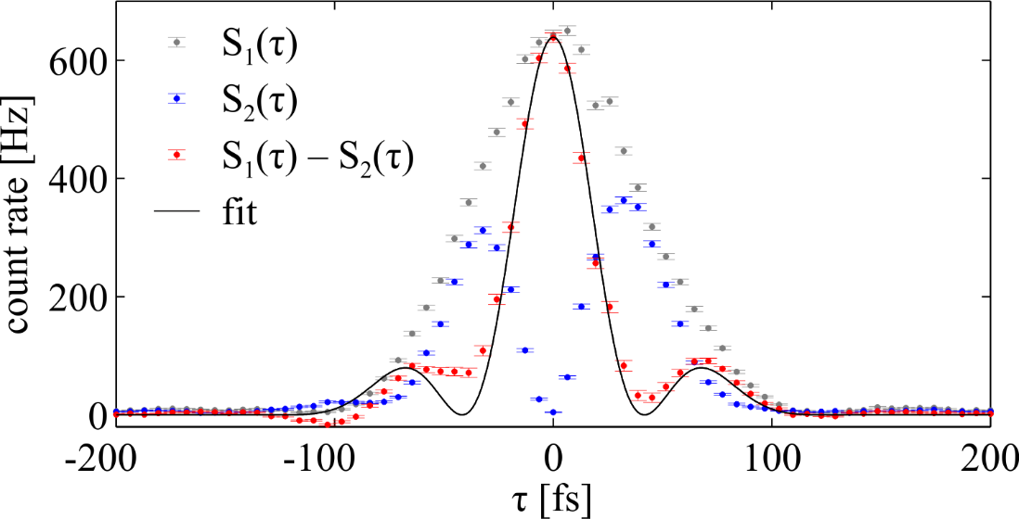
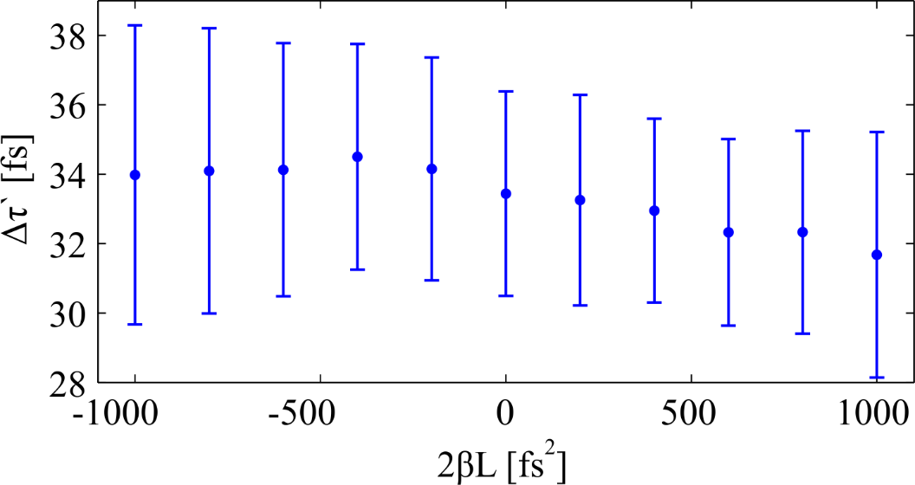
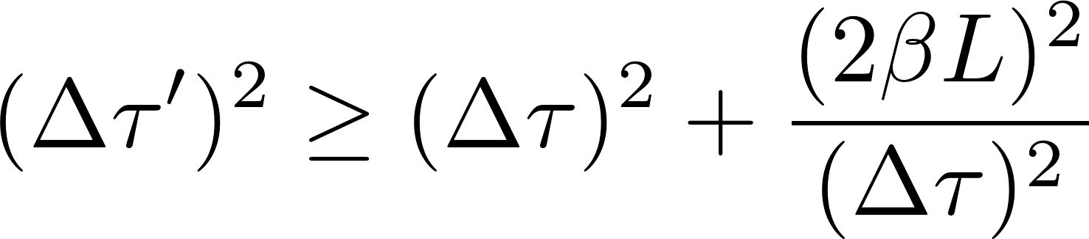
Violation of classical inequality
No broadening observed
Because of entanglement
S.Lerch, et al., JOSA B, 50, 055505 (2017)

Slide 27


Two photon imaging through scattering media
Classical light pulses
Photon pairs
Time gate
I(t)
Scattering media
Coincidence detection
|Ψ(t)|²
Coffee cream
Scattering media

Slide 28
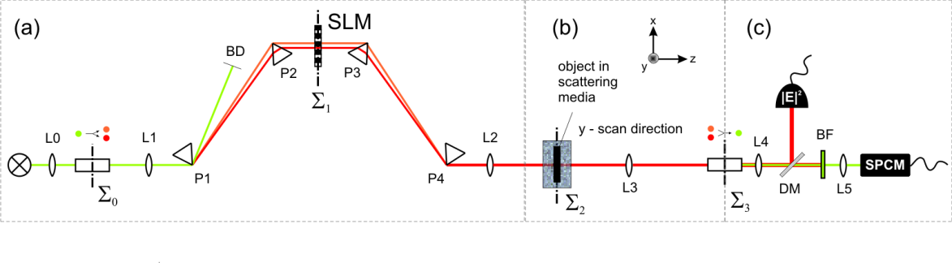
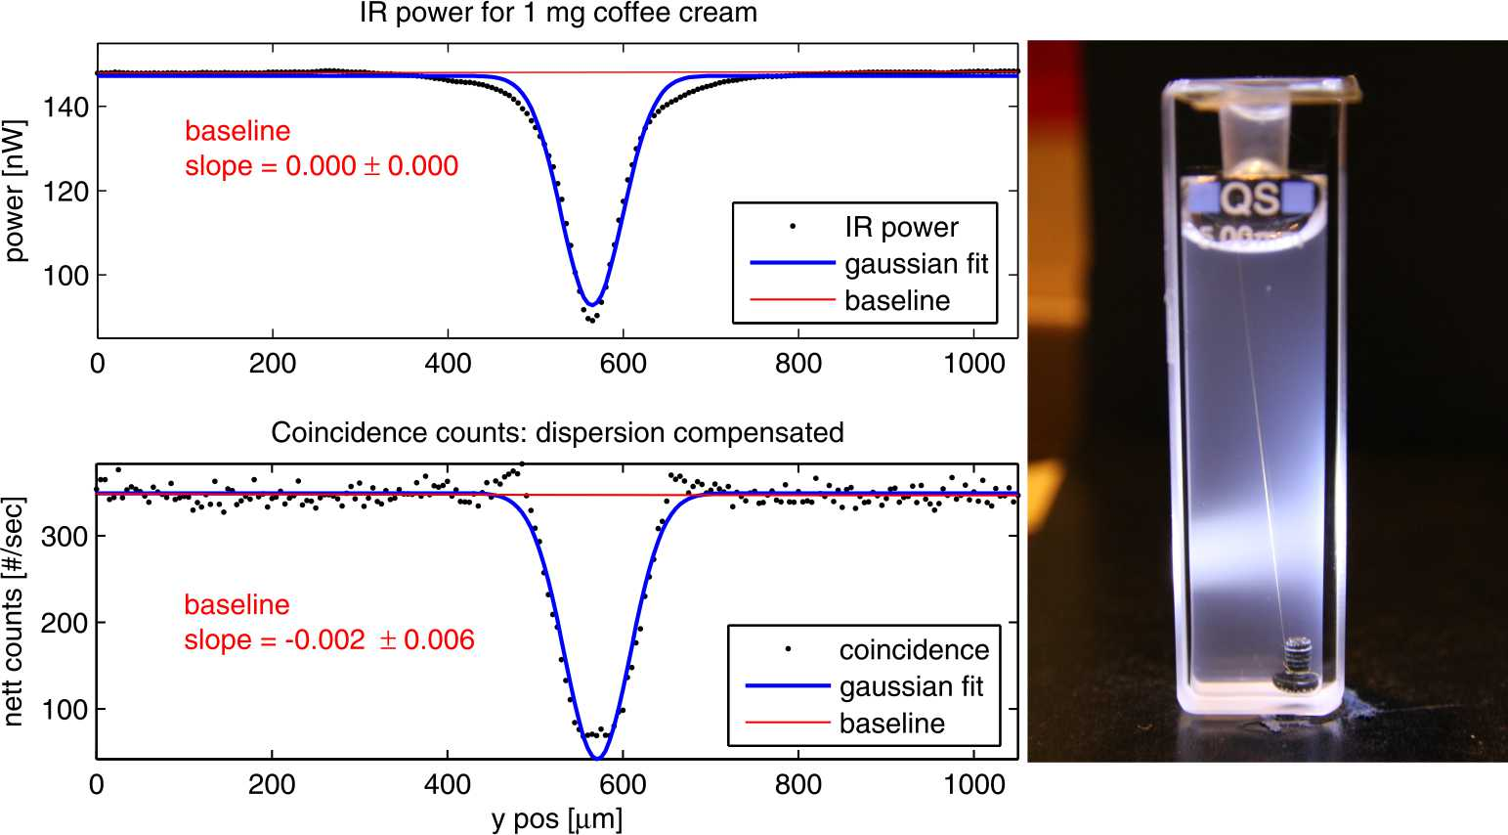
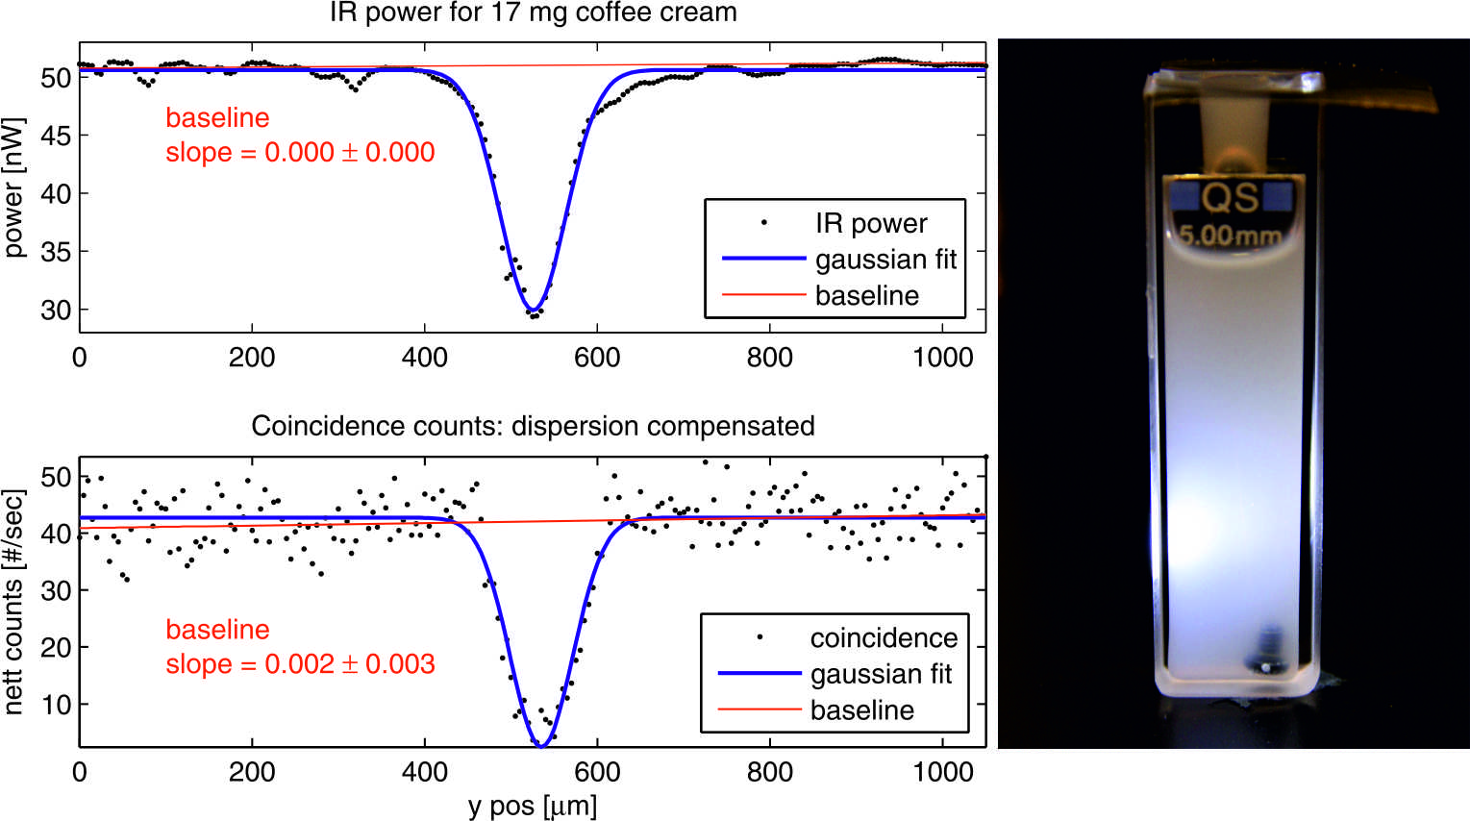
Two photon scattering: Experience
Ultrafast coincidences by sum frequency generation
C. Bernhard, et al., in Proc. SPIE 9721, Nanoscale Imaging, Sensing, Actuation Biomed. Appl. XIII, (2016), p. 97210L

Slide 29
How much of Quantum in Metrology?
Quantumness
Genuine entanglement
  NOON states
  Optical coherence tomography
  Quantum spectroscopy
Classical correlations
  Temporal/dispersion measurements
  Ghost imaging/spectroscopy
Quantum inspired classical optics methods
  Quantum tomography
Experimental
practicability

Slide 30
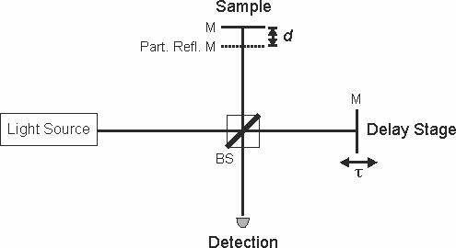
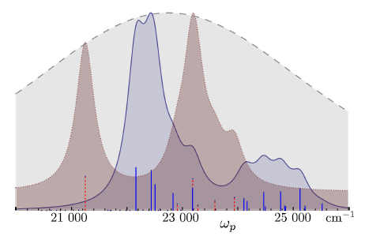
Role of entanglement
Classical correlations: in one basis (i.e time)
Quantum correlations:in complementary bases (i.e. time-energy)
ρ
Only classical temporal correlations are relevant
φ
One photon scattering
Entangling
operation
ρ
φ
Entanglement
Is required
Two photon interferences
ρ
φ
Two photon spectroscopy
A. Stefanov, Quantum Sci. Technol. 2, 25004 (2017).

Slide 31
Spectroscopy with entangled photons
Two photon absorption
Parameters of the incoming light state:
central wavelength ω_{cp}
relative delay between the two photons τ
Bandwidth of the photons 1/T
Absorber

Slide 32
Spectroscopy with entangled photon
Three levels toy system
τ: delay between both photon

Slide 33
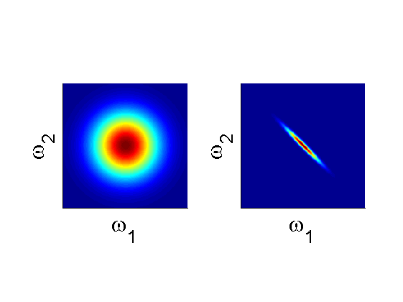


Spectroscopy with entangled photons
central wavelength ω_{cp}
relative delay between the two photons τ
Bandwidth of the photons 1/T
A:Separable B:Entangled
B
CW lasers
A
Fluorescence action spectra
vs pump frequency
K. E. Dorfman, F. Schlawin, and S. Mukamel, Rev. Mod. Phys. 88, 45008 (2016).

Slide 34
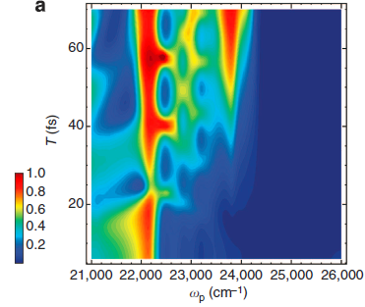
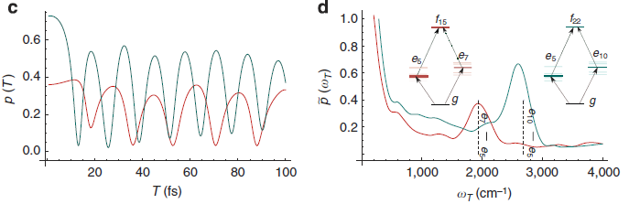
Spectroscopy with entangled photons
Non-monotonic change of the transition probability gives information about the intermediate levels.

Slide 35
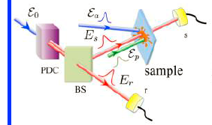
Role of entanglement
Dorfman, K. E., Schlawin, F., & Mukamel, S. Stimulated Raman Spectroscopy with Entangled Light: Enhanced Resolution and Pathway Selection. J. of Phys. Chem. Lett., 5(16), 2843–2849, 2014
Again entanglement is not needed
Preparation
ρ₁
Absorber
Absorber
ρ₁₂
A. Stefanov, Quantum Sci. Technol. 2, 25004 (2017).

Slide 36
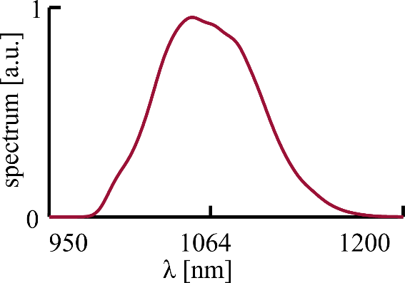

From entanglement to classical correlation
Entangled two-photon state
Random phase at SLM → destroy fixed phase relation (coherence) between signal and idler
signal
idler
phase
0
State becomes a weighted mixture
Quantum correlations
Classical correlations

Slide 37

From entanglement to classical correlation
Arrival time difference between signal and idler
Lerch, S., & Stefanov, A. (2018). Comm. Phys., (2018), 1–6.

Slide 38
Toward spectroscopy
Fluorescence detection
Possible samples:
Fluorescent molecules
Quantum dots
Atoms (Rb)
Multi-photon emission from metal tip
Nano structures

Slide 39





Ackowledgement
B. Bessire
C. Bernhard
S. Lerch
S. Schwarz
M. Unternährer
J. Kohn
Thank you for your attention!

